Slide 1
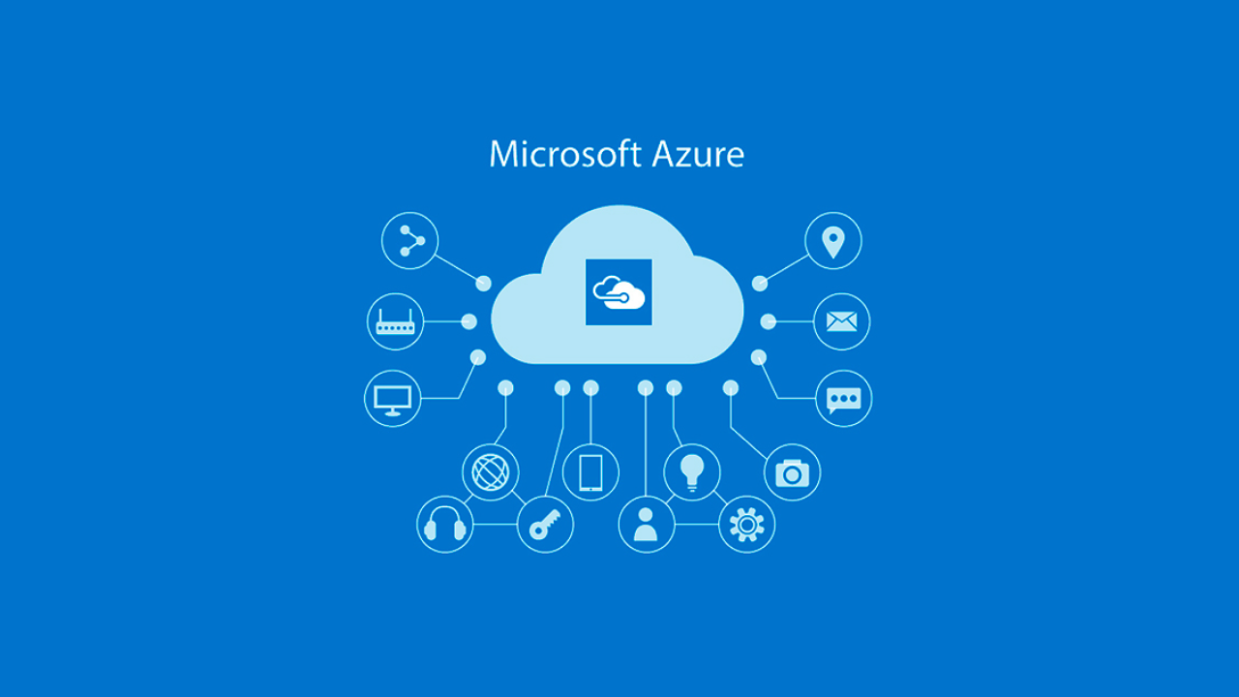

Slide 2
Implementing a Scalable Data Engineering Solution for COVID-19 Trends Analysis and Prediction using Azure Data Factory
The COVID-19 pandemic needed a sophisticated data system to detect trends and anticipate viral propagation. Organizations and healthcare providers require COVID-19 data reporting that is accurate, timely, and consistent in order to make decisions and allocate resources effectively. Traditional data management approaches struggle to handle the amount, pace, and variety of pandemic data. Furthermore, they lack efficient, scalable systems for integrating several data sources and performing real-time analytics.
To solve these difficulties, this project intends to provide a cloud-based data engineering solution that uses Azure Data Factory (ADF) as the primary pipeline management tool, combining and converting data from many sources to enable data-driven insights. By leveraging Azure Storage, Databricks, HDInsight, and Power BI, this solution will produce daily updated reports and visualizations to assist in tracking COVID-19 trends.

Slide 3
Objectives
Data Ingestion & Integration - Consolidate COVID-19 data from sources like HTTP APIs, Azure Blob Storage, and Azure Data Lake Gen2 to manage historical and real-time data streams.
Data Transformation & Processing - Design ADF pipelines for data cleaning and enrichment, implementing Mapping Data Flows for transformation logic (e.g., filtering, joining, aggregation) and using Databricks for advanced processing and HDInsight with Hive for batch tasks.
Data Orchestration & Scheduling - Establish dependencies between pipelines and triggers to manage data flows, enabling real-time orchestration and monitoring.
Data Storage & Access Control - Manage secure storage with Azure Data Lake Gen2 and Azure SQL Database, enforcing role-based access.
Monitoring & Alerting - Use Azure Monitor and Log Analytics for real-time pipeline monitoring and diagnostics.
CI/CD Integration - Implement Azure DevOps pipelines for reliable development and deployment across environments.

Slide 4
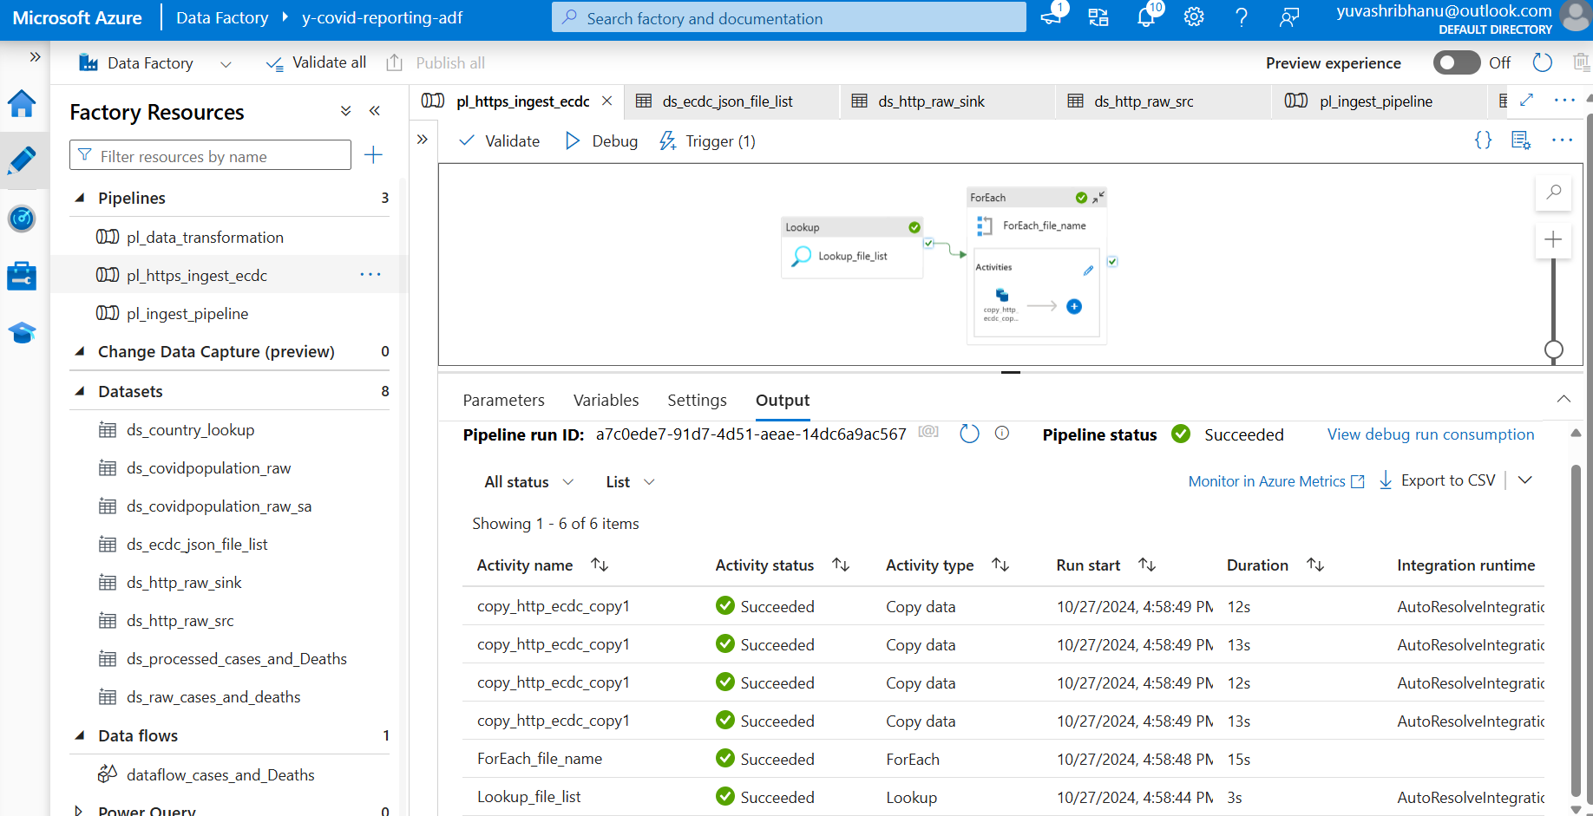
Data Ingestion & Integration
Pipeline to ingest data from http source

Slide 5
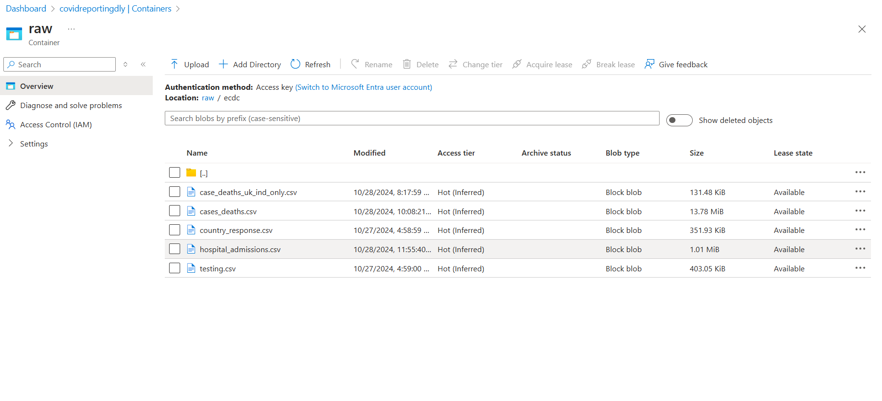
Data Ingestion & Integration
Ingested Files

Slide 6
Data Ingestion & Integration
Ingested Files

Slide 7
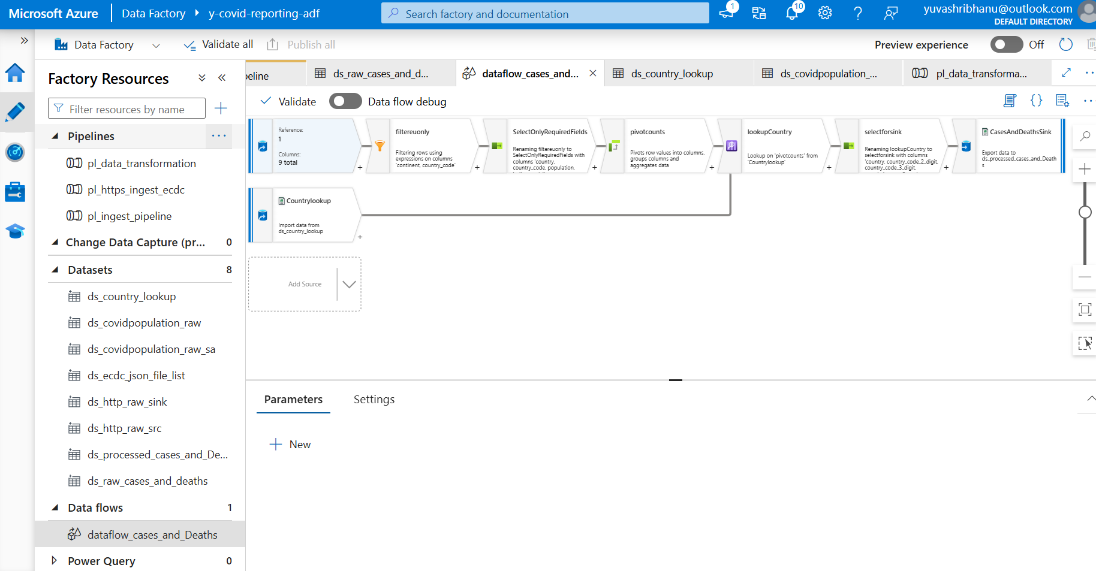
Data Transformation & Processing
Data Flow for Cases and Deaths file

Slide 8
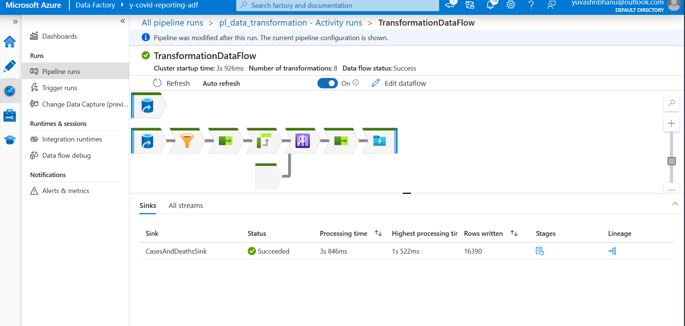
Data Transformation & Processing
Data Flow runtime for Cases and Deaths file

Slide 9
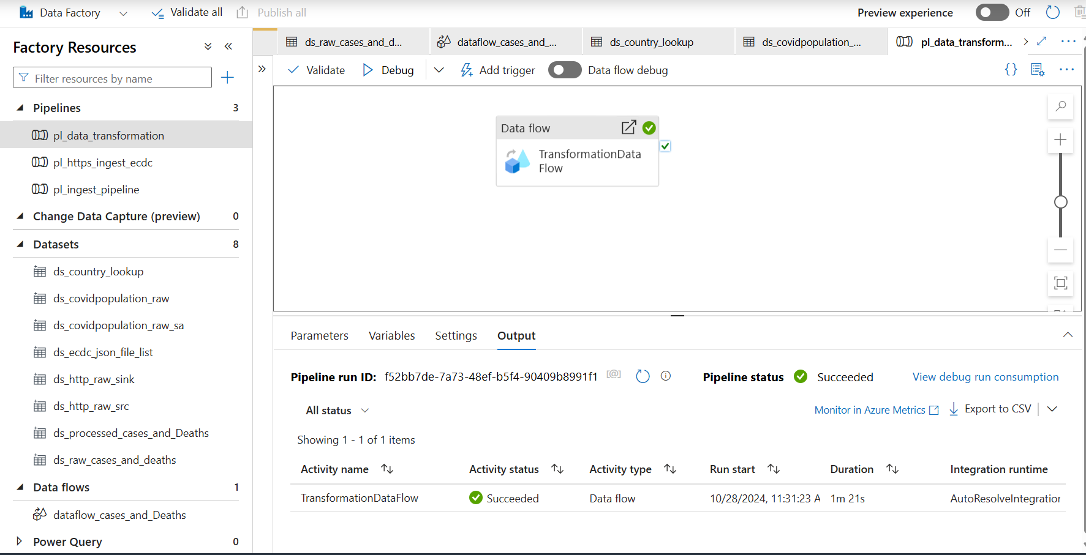
Data Orchestration & Scheduling
Pipe line to run the Cases and deaths data flow and the runtime

Slide 10
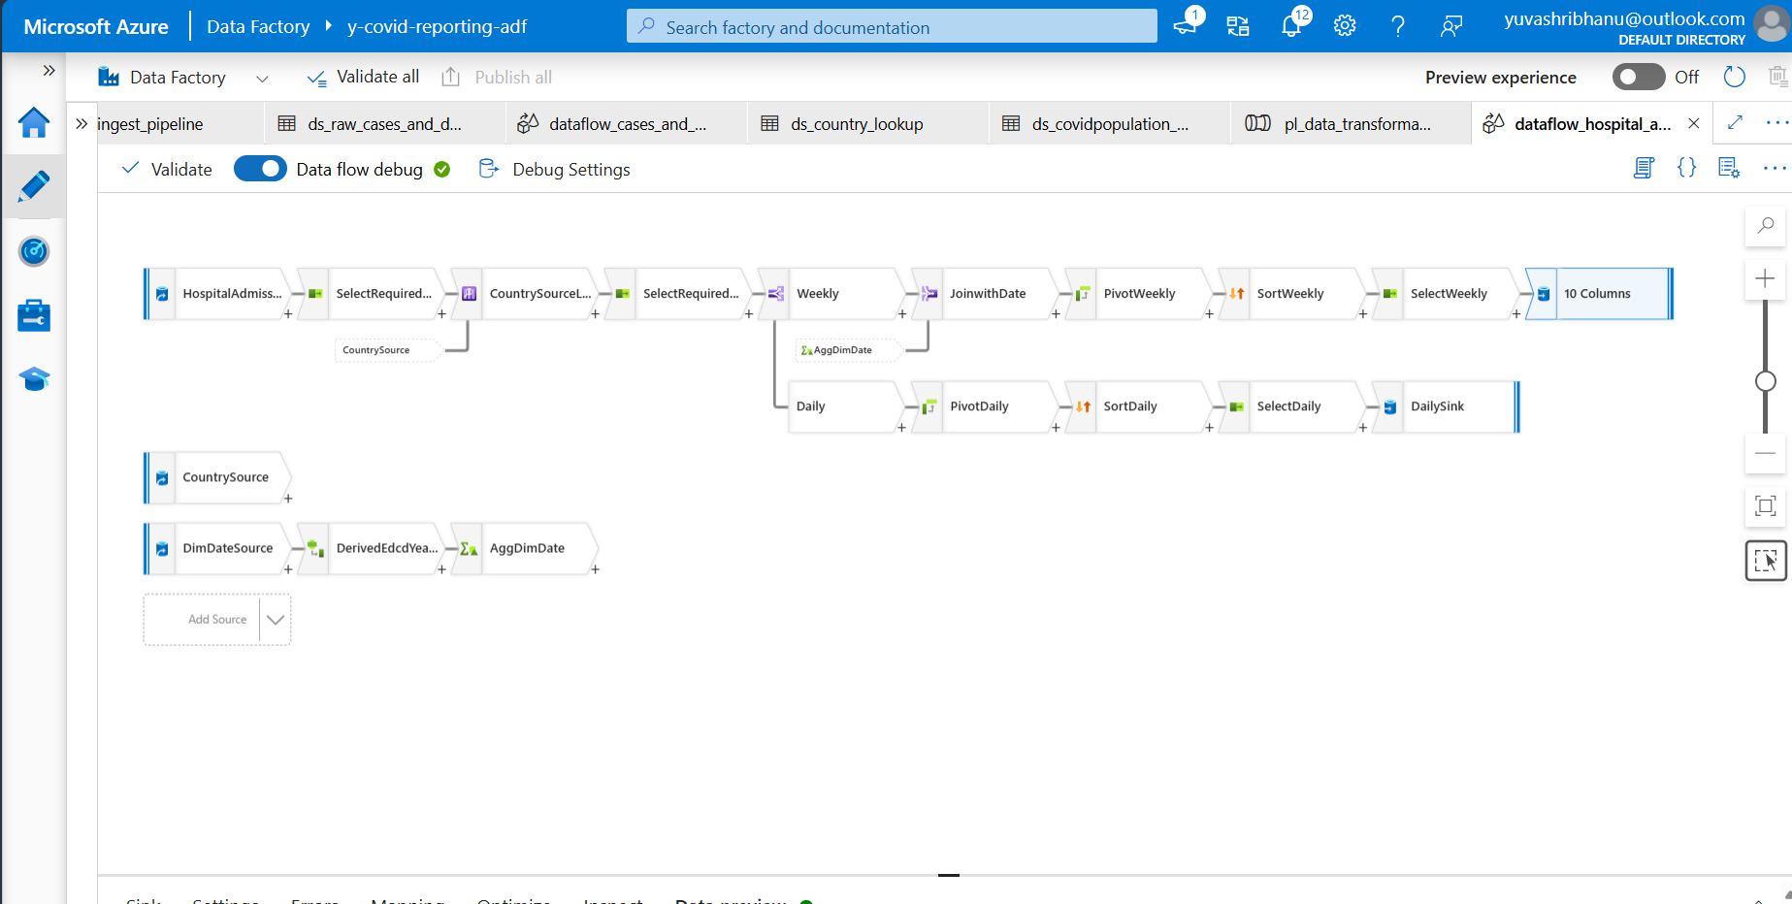
Data Transformation & Processing
Data Flow for hospital admissions file

Slide 11
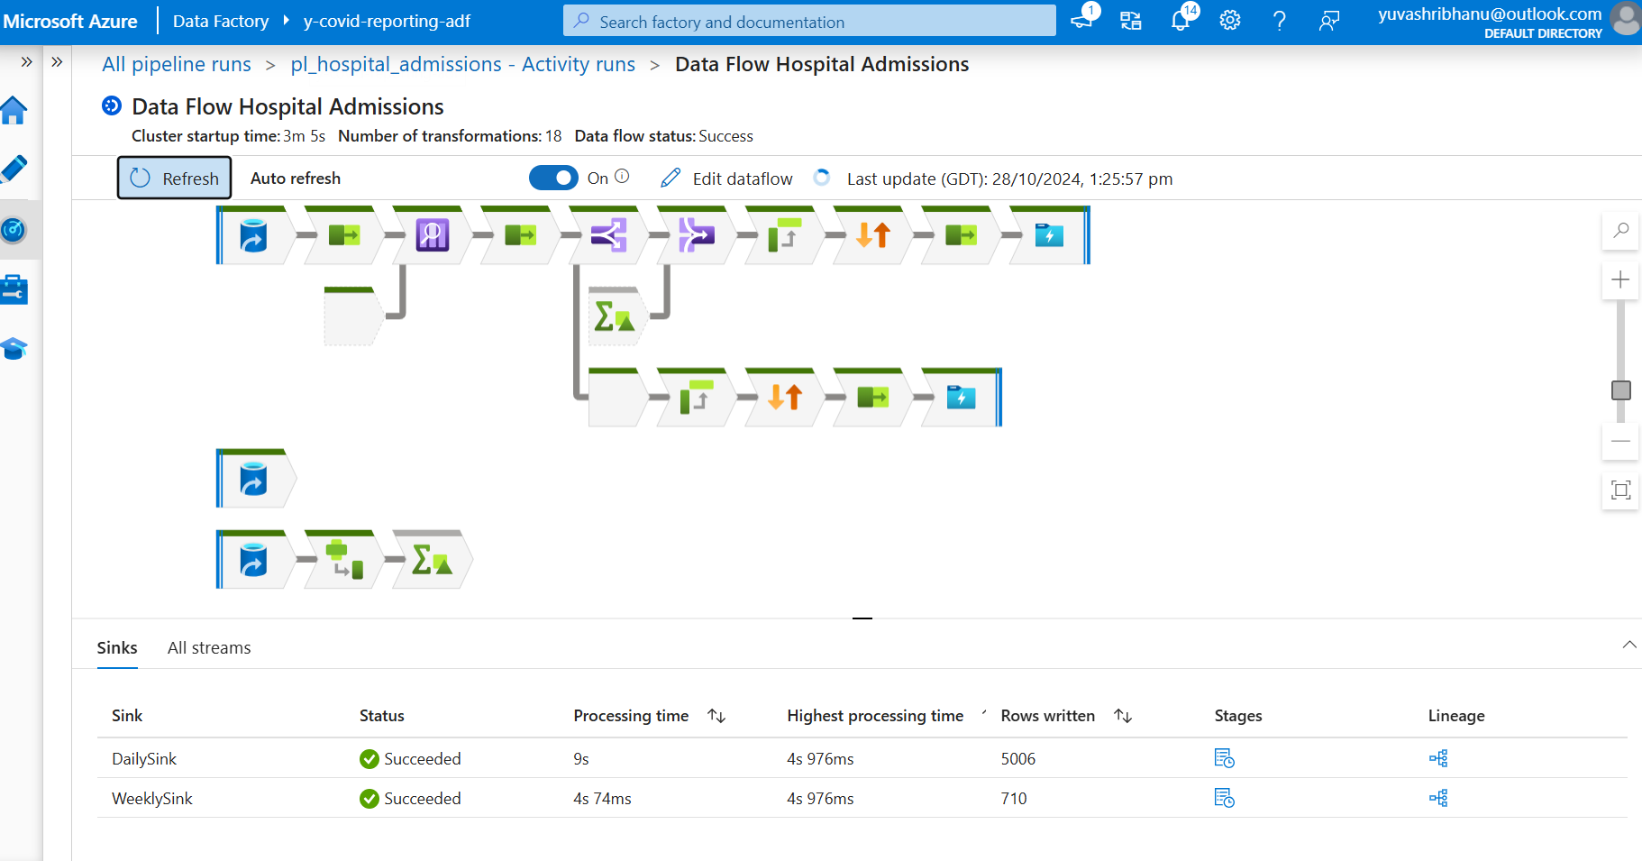
Data Transformation & Processing
Data Flow runtime for hospital admissions file

Slide 12
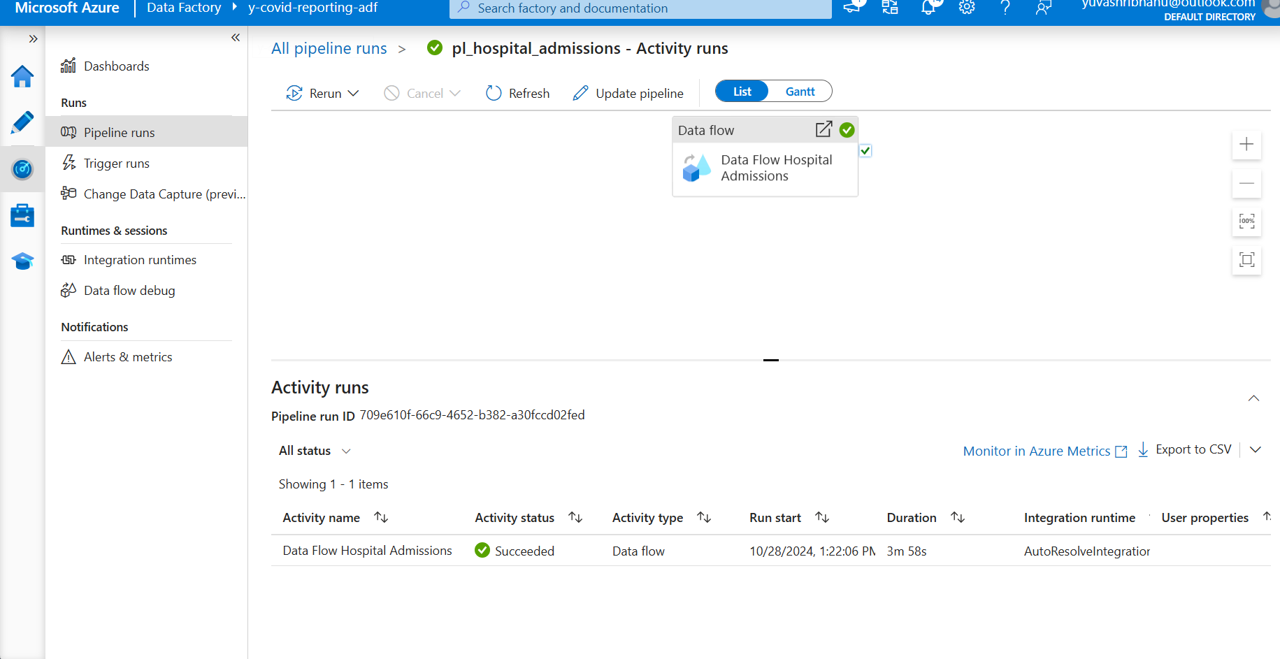
Data Orchestration & Scheduling
Pipeline for hospital admissions data flow and its runtime

Slide 13
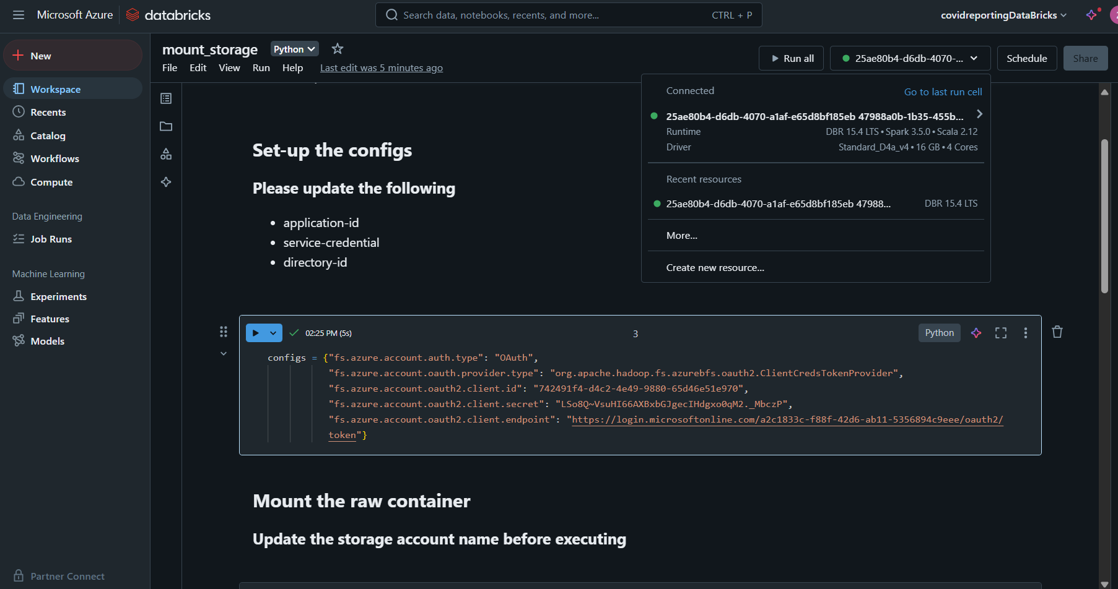
Data Transformation & Processing
Create an HDInsight cluster and connect it to Databricks. In Databricks, use Python code to mount the files for easy access.

Slide 14
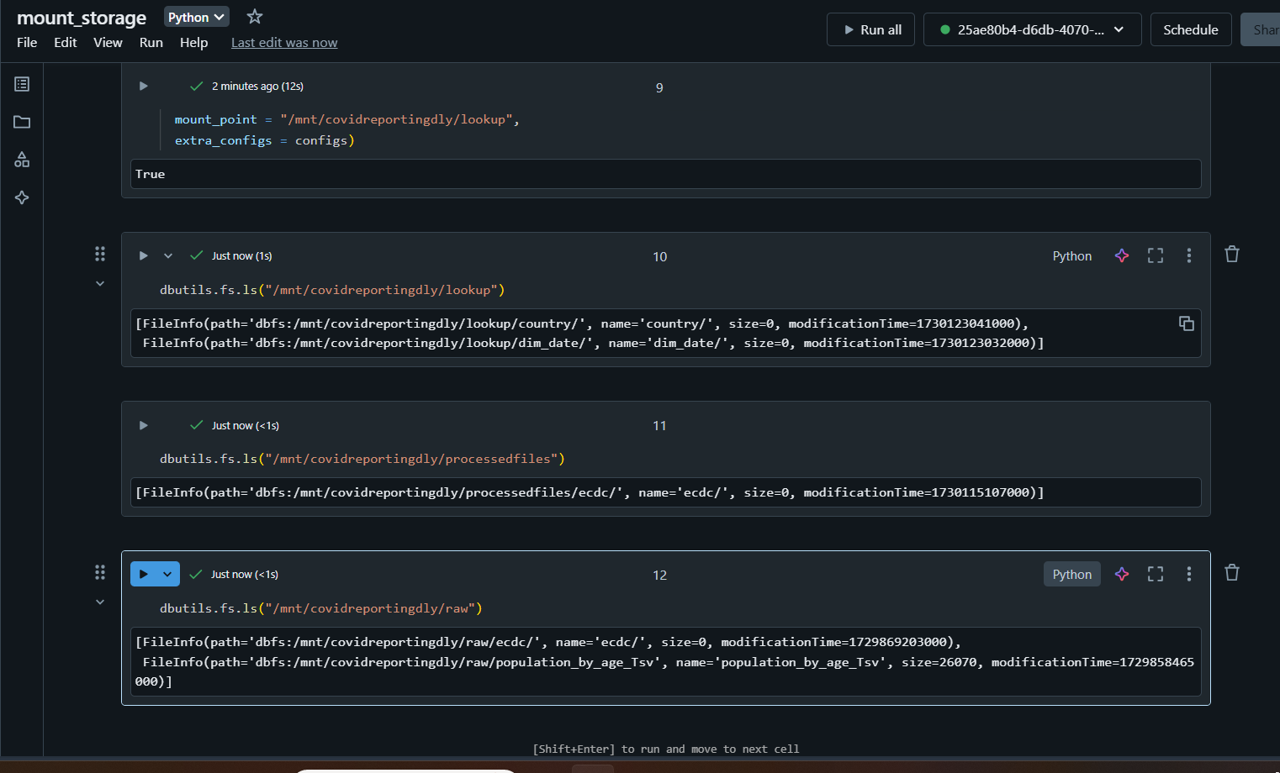
Data Transformation & Processing
Files mounted

Slide 15
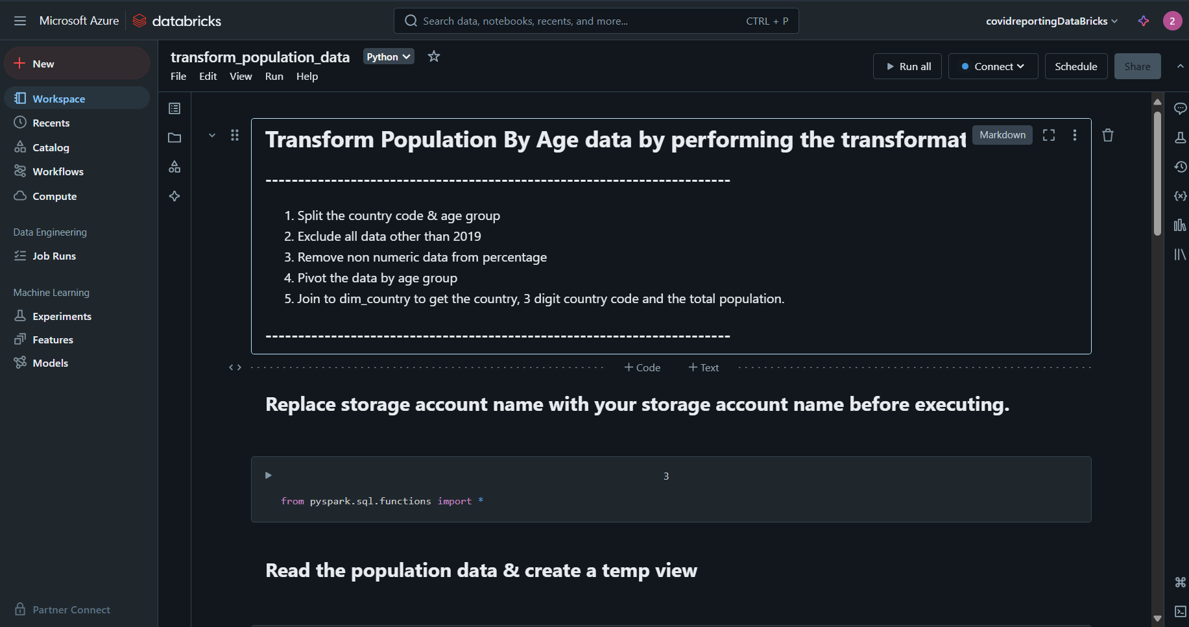
Data Transformation & Processing
Import transformation file which has all the necessary data transformation written in python. The file will look similar to the above image

Slide 16
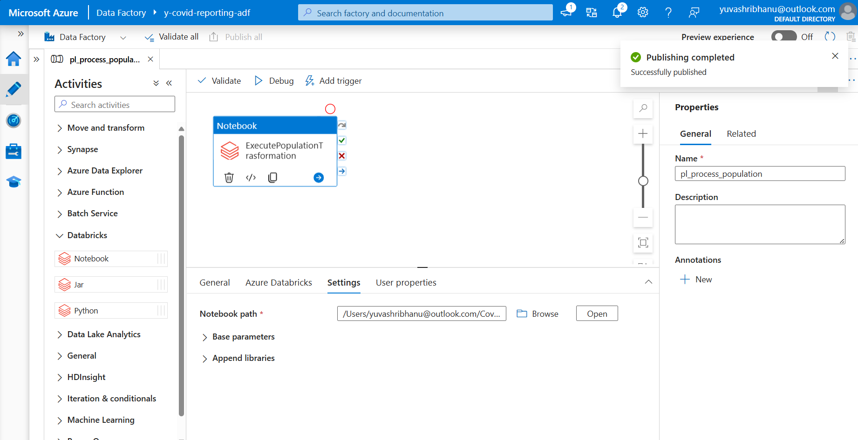
Data Orchestration & Scheduling
Pipeline for executing data bricks notebook

Slide 17
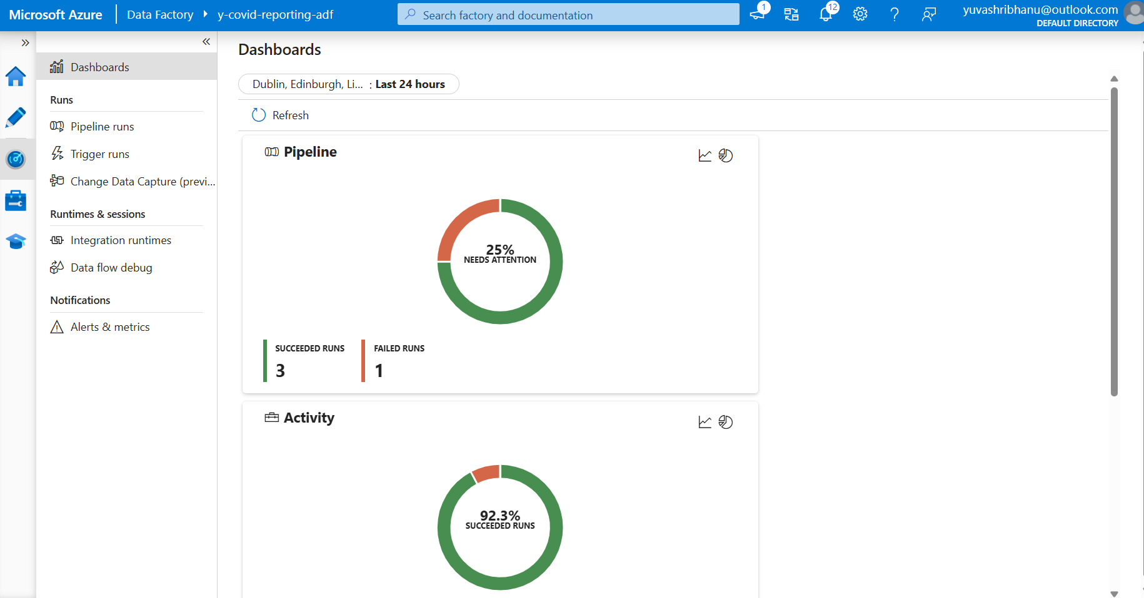
Monitoring
Data Factory monitoring dashboard

Slide 18
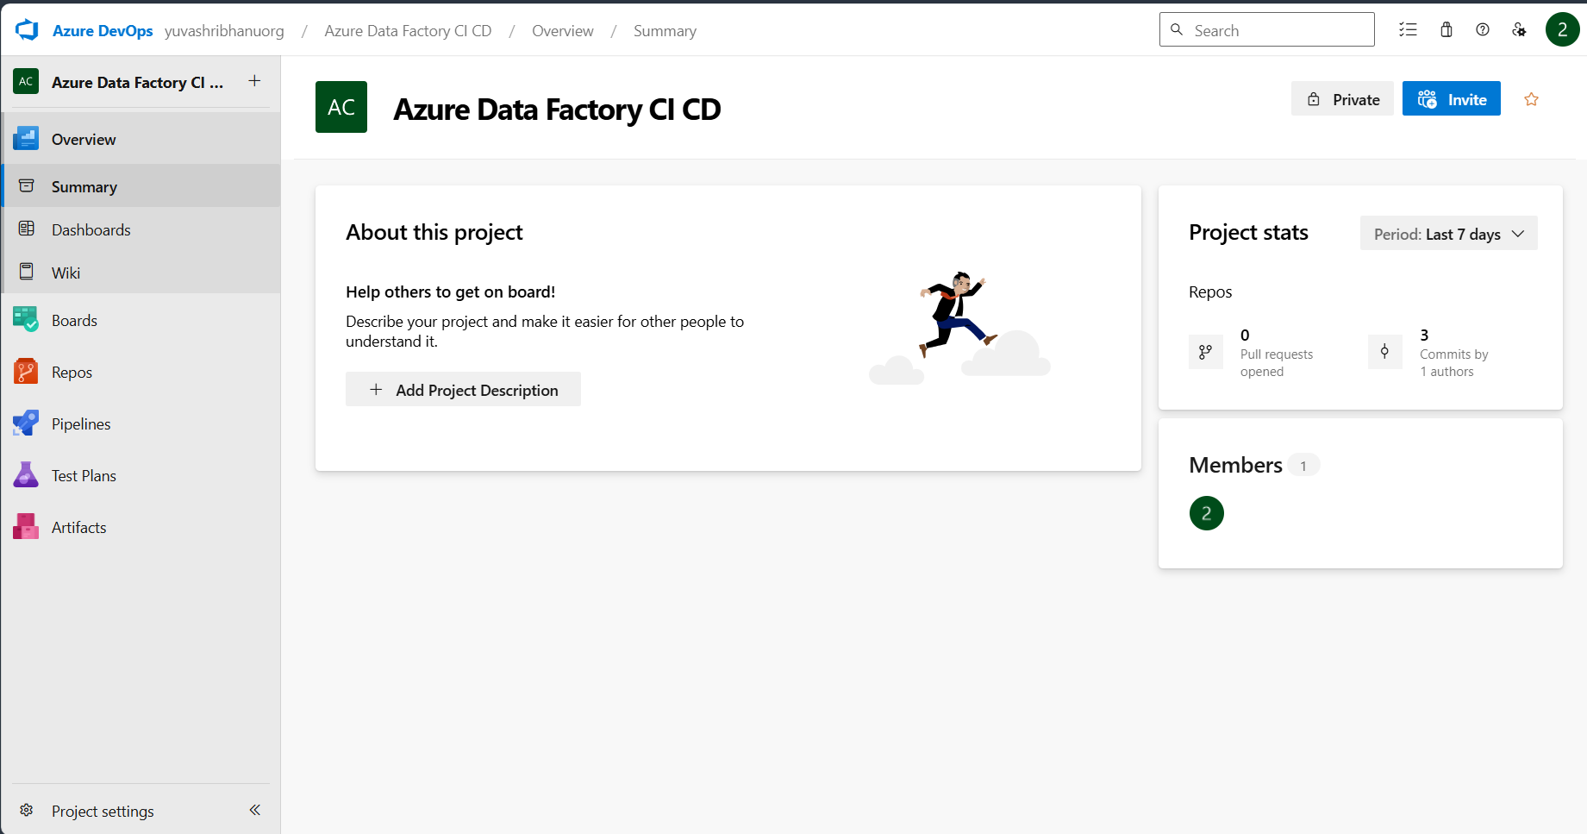
CI/CD Integration
Azure DevOps project creation

Slide 19
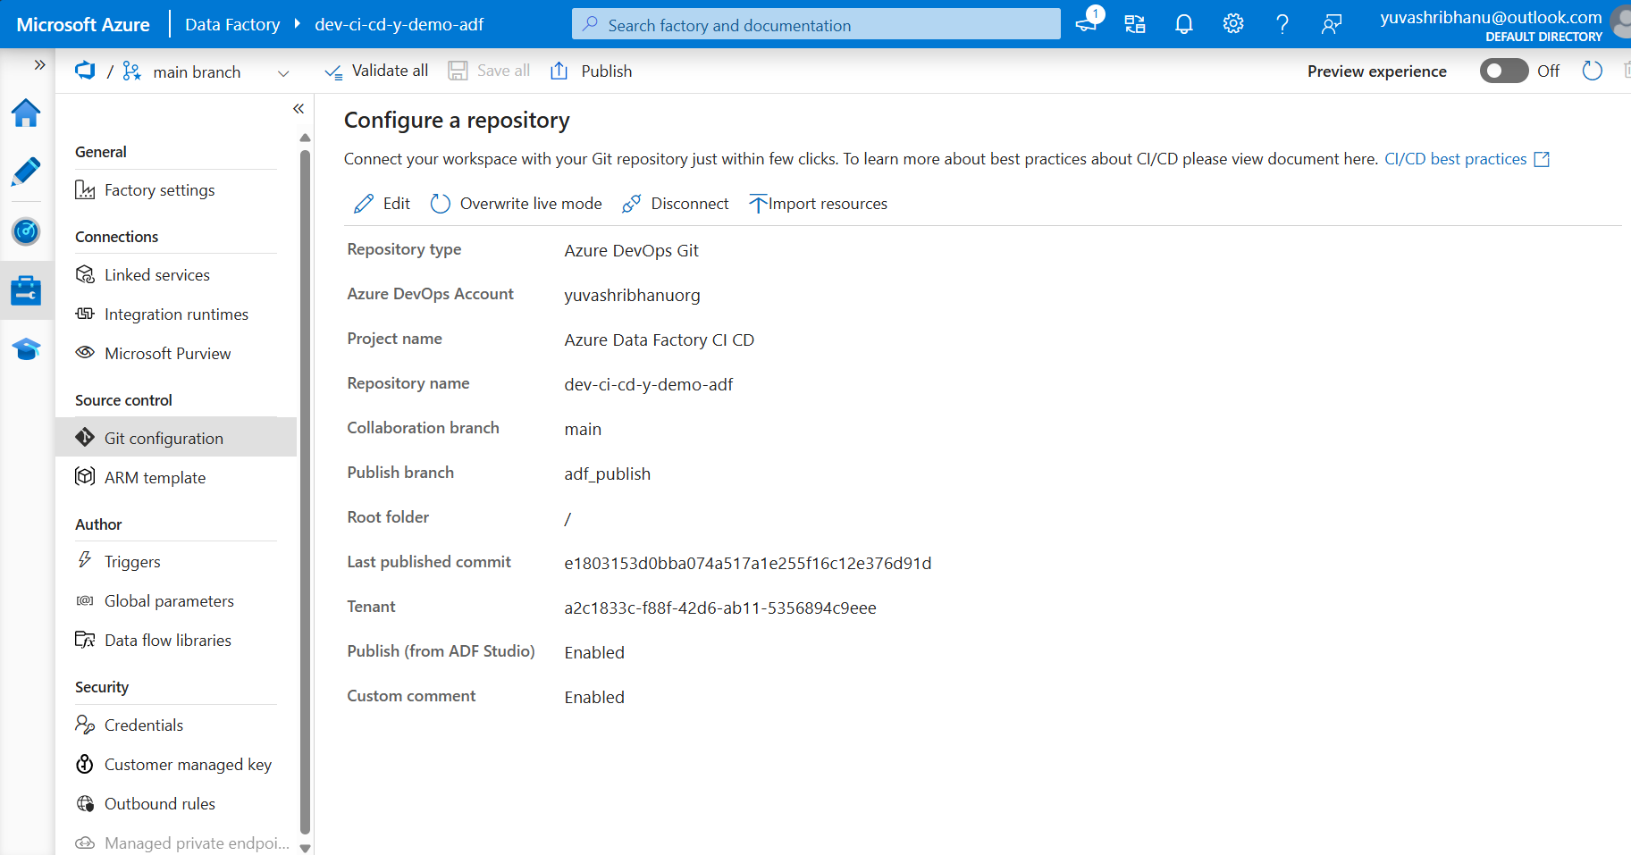
CI/CD Integration
Git configuration for Data factory(Dev)

Slide 20
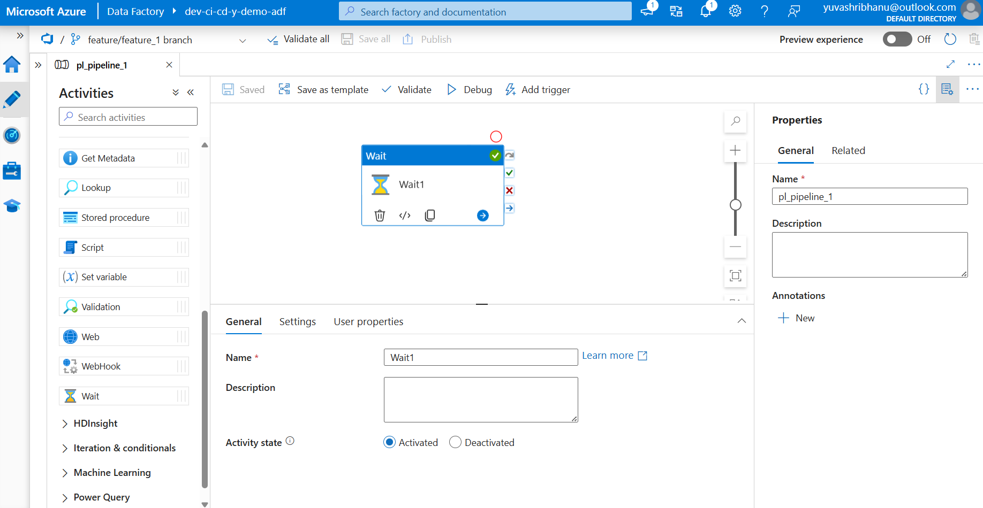
CI/CD Integration
Sample demo pipeline created in feature branch

Slide 21
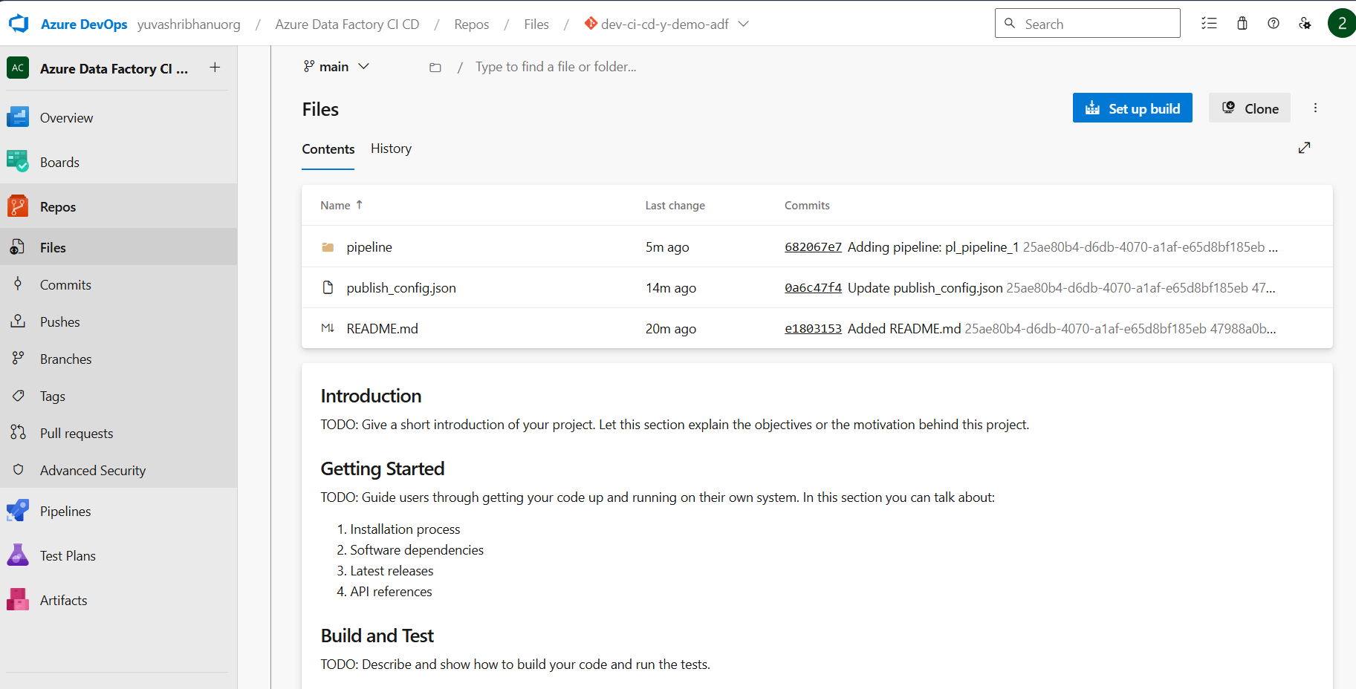
CI/CD Integration
Git repository merge. Pipeline merged in main branch.

Slide 22
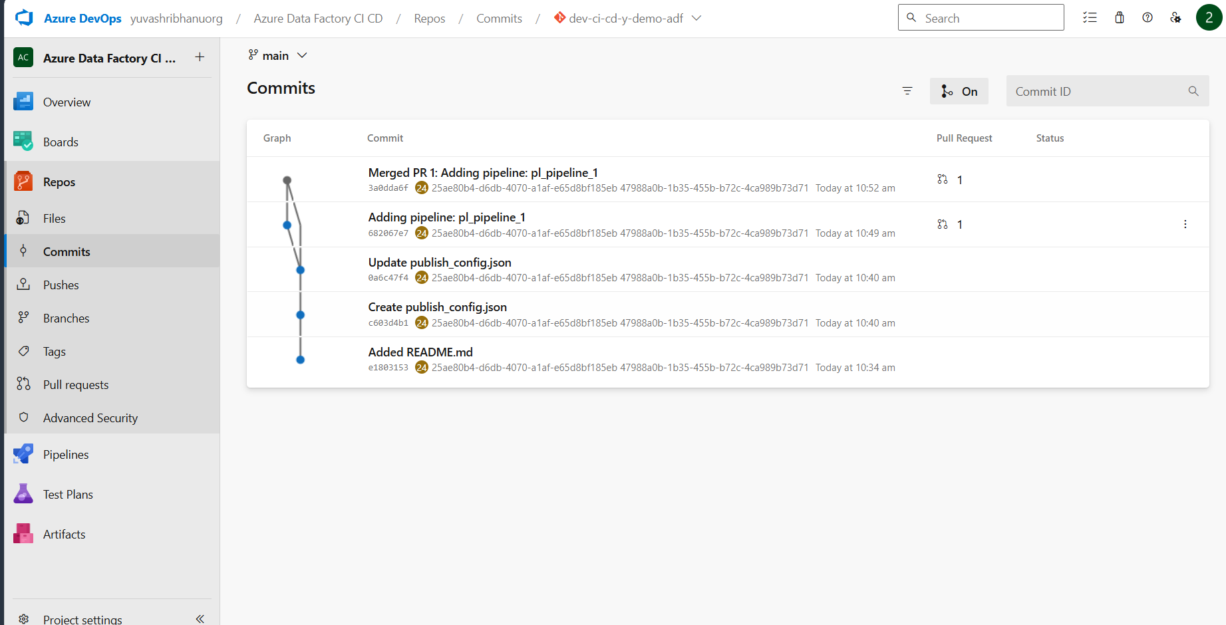
CI/CD Integration
Git Commits

Slide 23
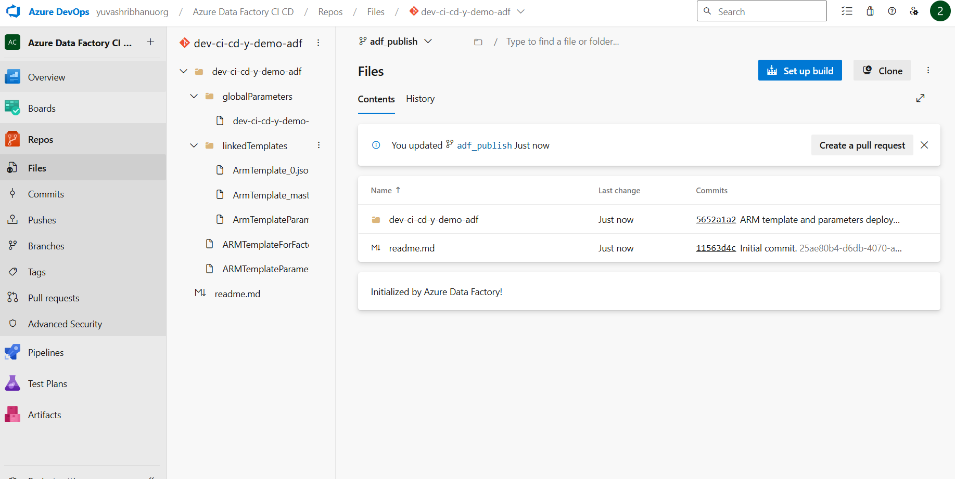
CI/CD Integration
Arm Templates created after publishing the pipeline

Slide 24
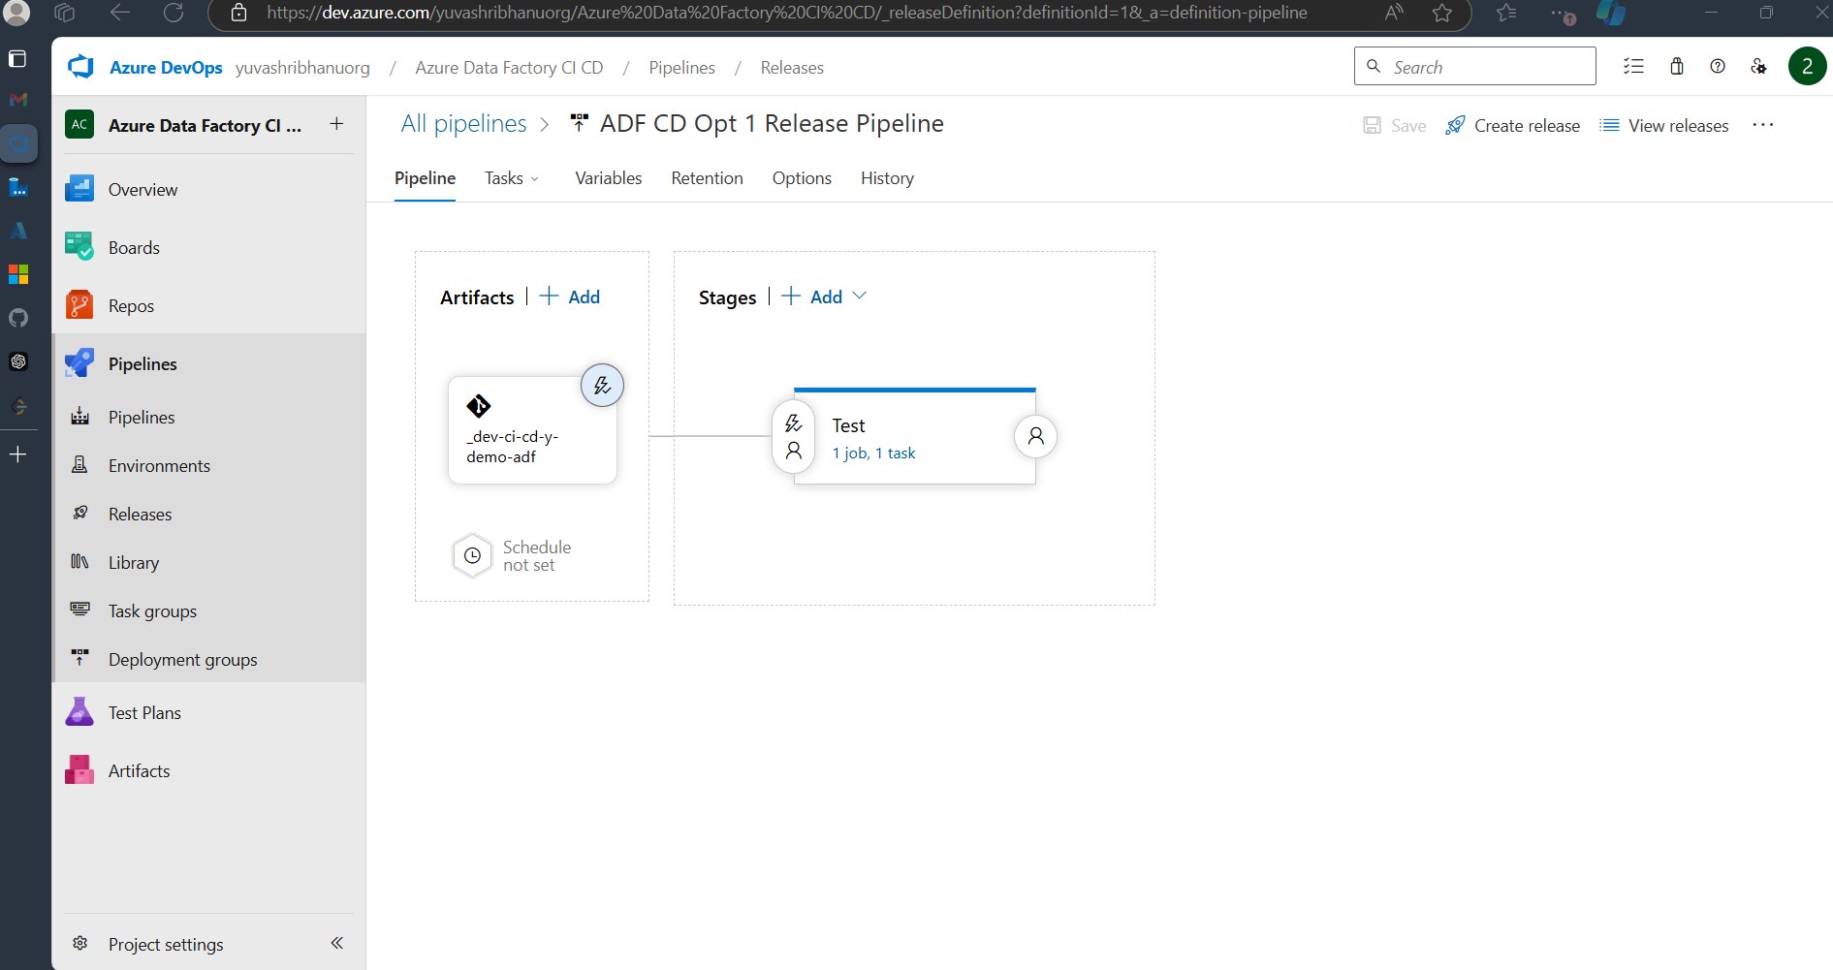
CI/CD Integration
Release Pipeline

Slide 25
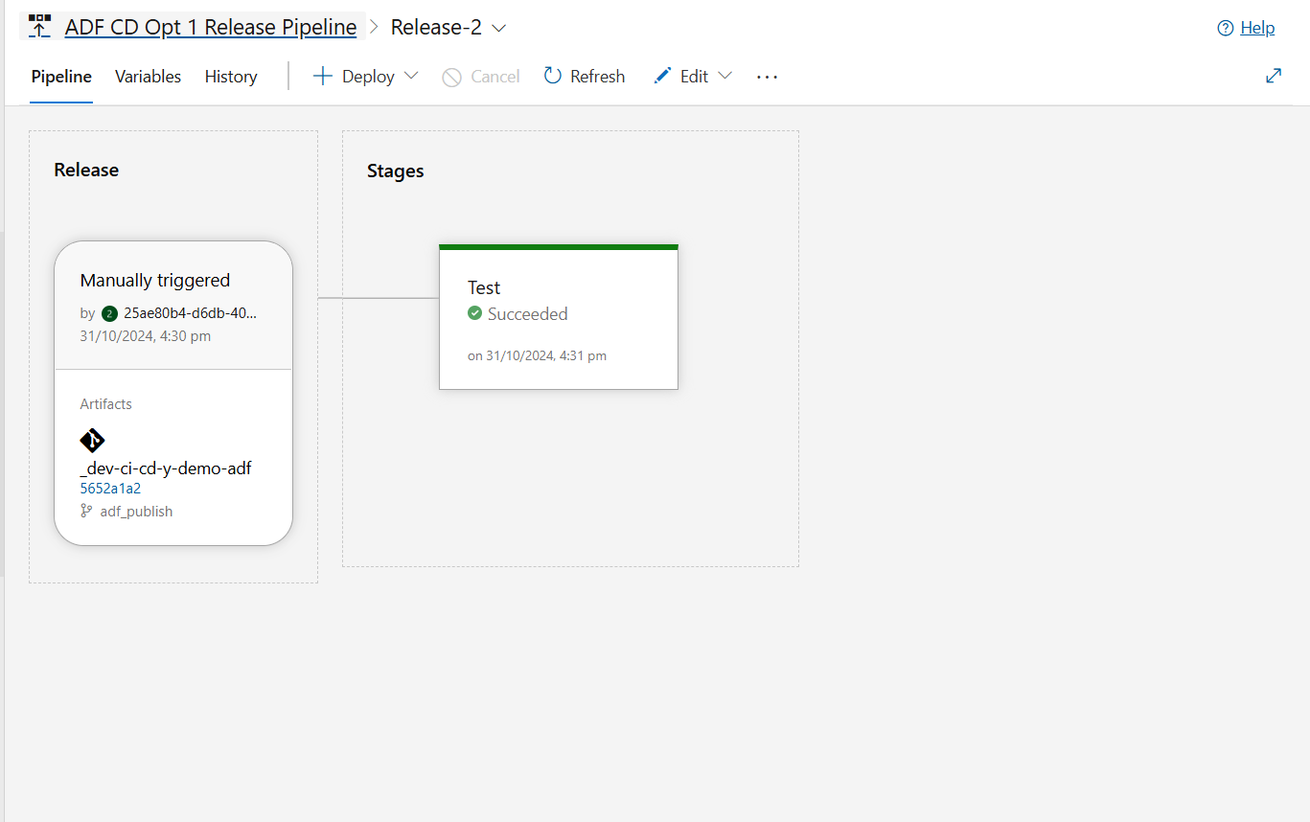
CI/CD Integration
Release Pipeline Runtime

Slide 26
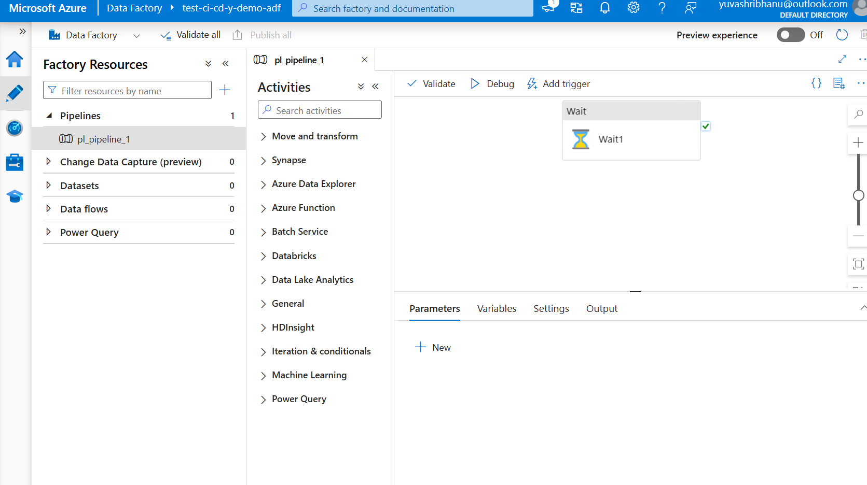
CI/CD Integration
Pipeline deployed from dev to test environment using azure devops

Slide 27
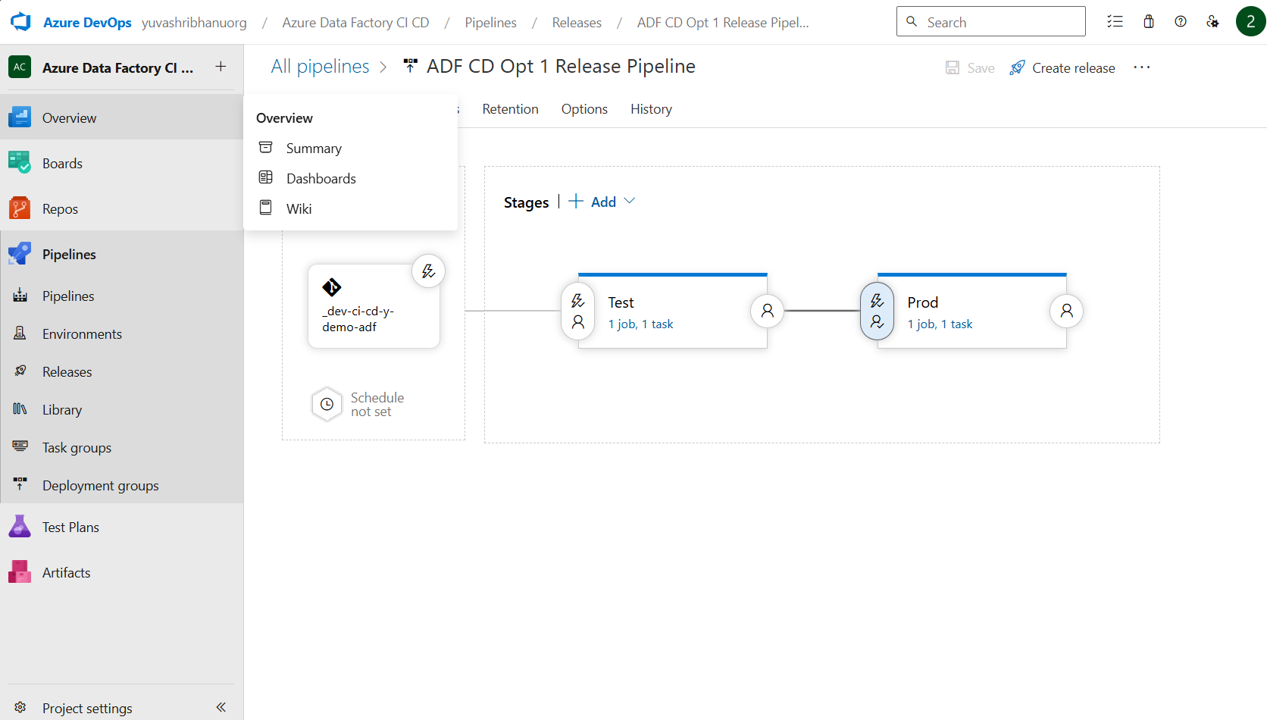
CI/CD Integration
Release pipeline for deploying in prod environments

Slide 28
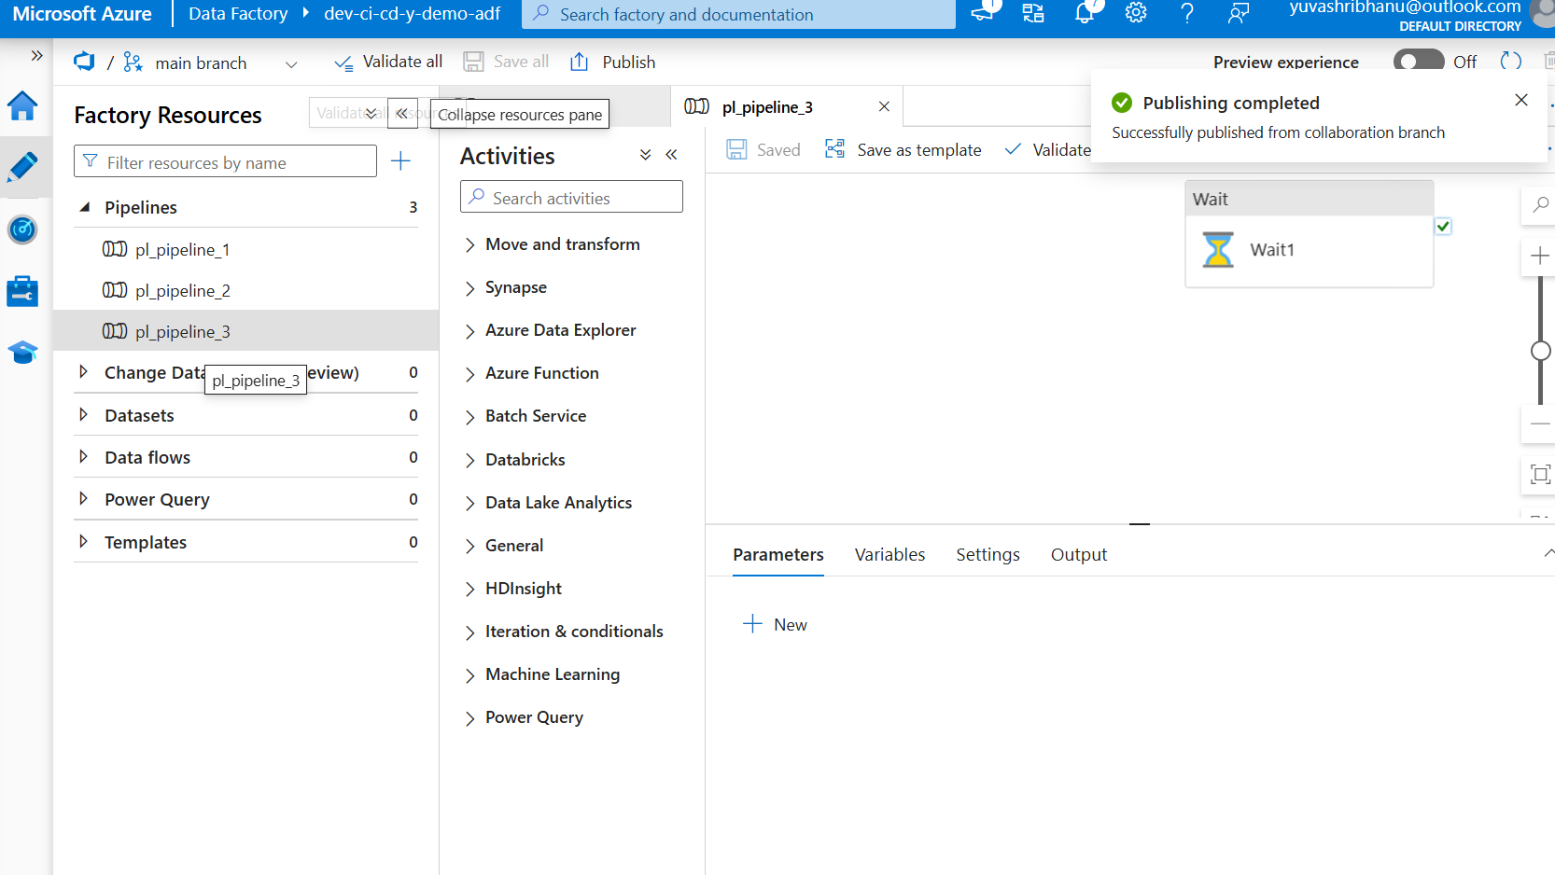
CI/CD Integration
New pipe line created and published in dev2 to test the release pipeline

Slide 29
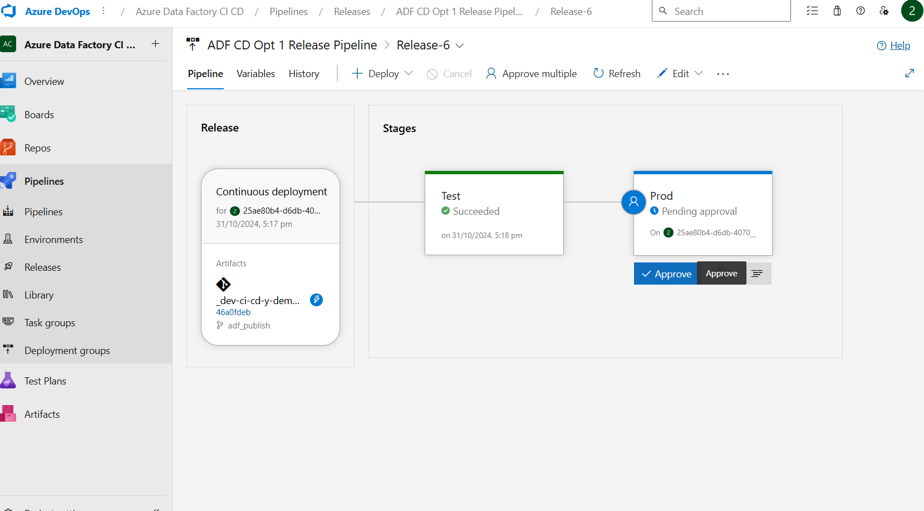
CI/CD Integration
Release pipeline running and waiting for approval to publish in prod

Slide 30
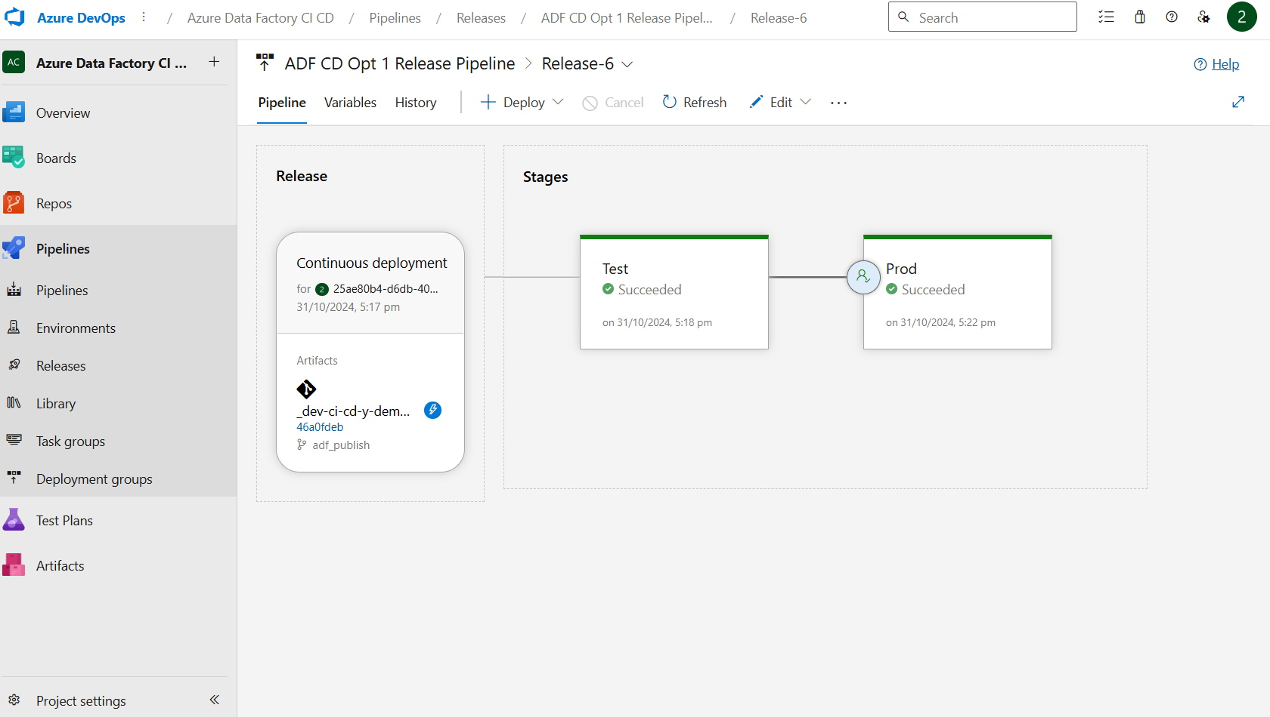
CI/CD Integration
Release pipeline success

Slide 31
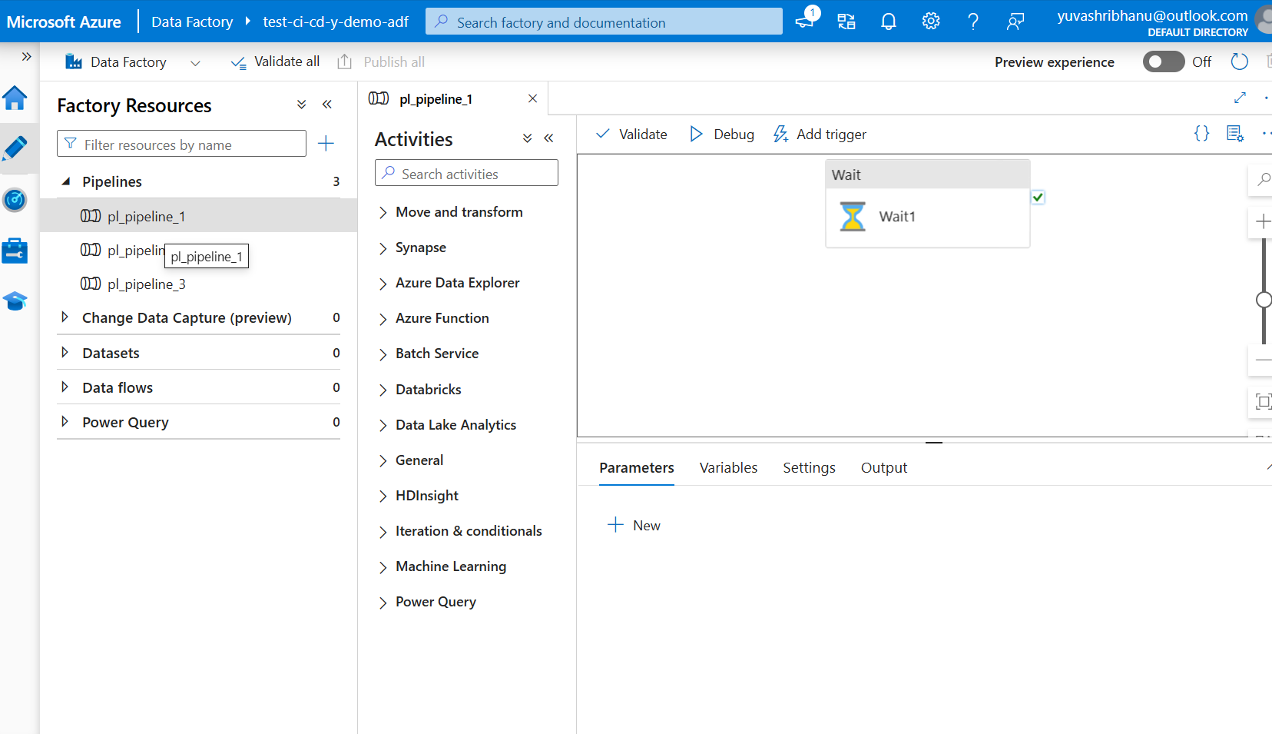
CI/CD Integration
Pipeline 3 in test environment

Slide 32
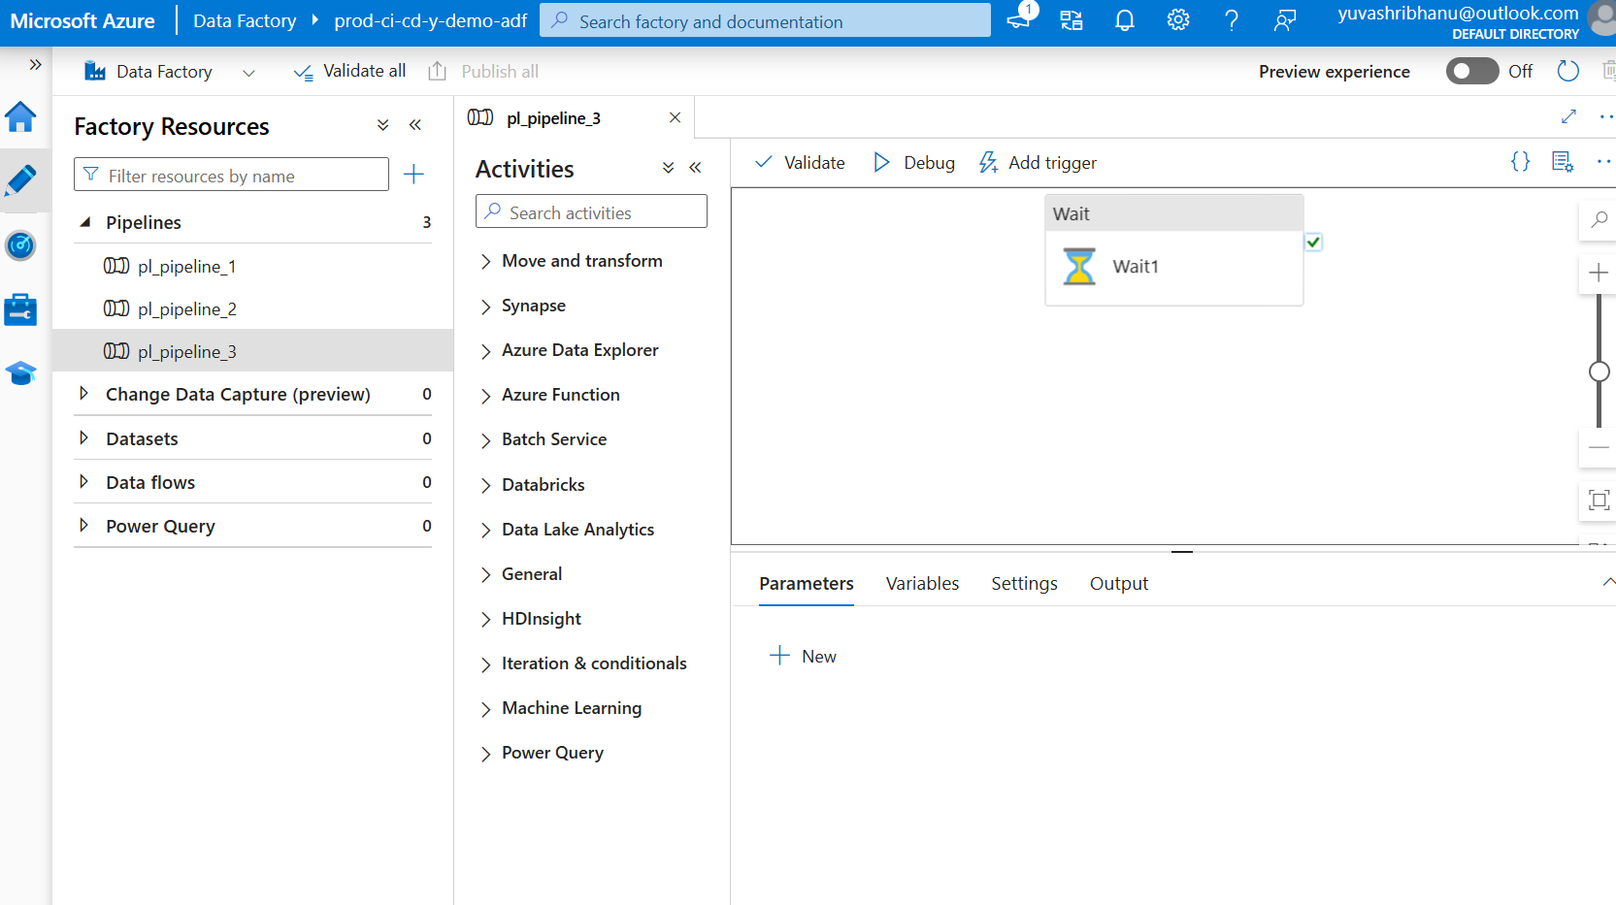
CI/CD Integration
Pipeline 3 in prod environment

Slide 33
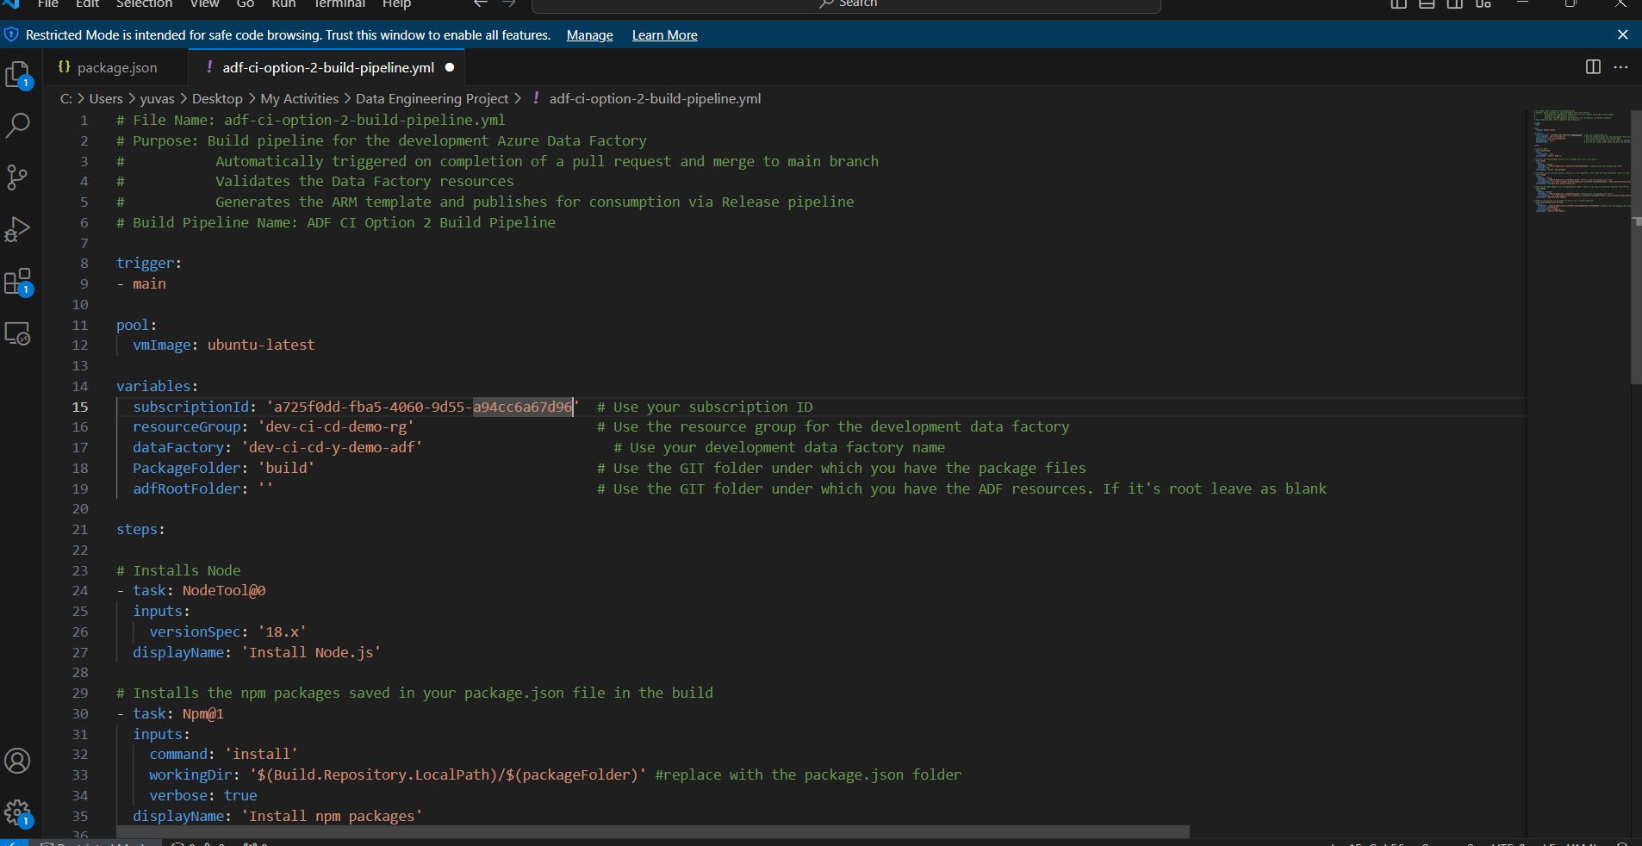
CI/CD Integration
Building pipeline using YAML Script to automate the publishing of arm templates. Above is the YAML Script used

Slide 34
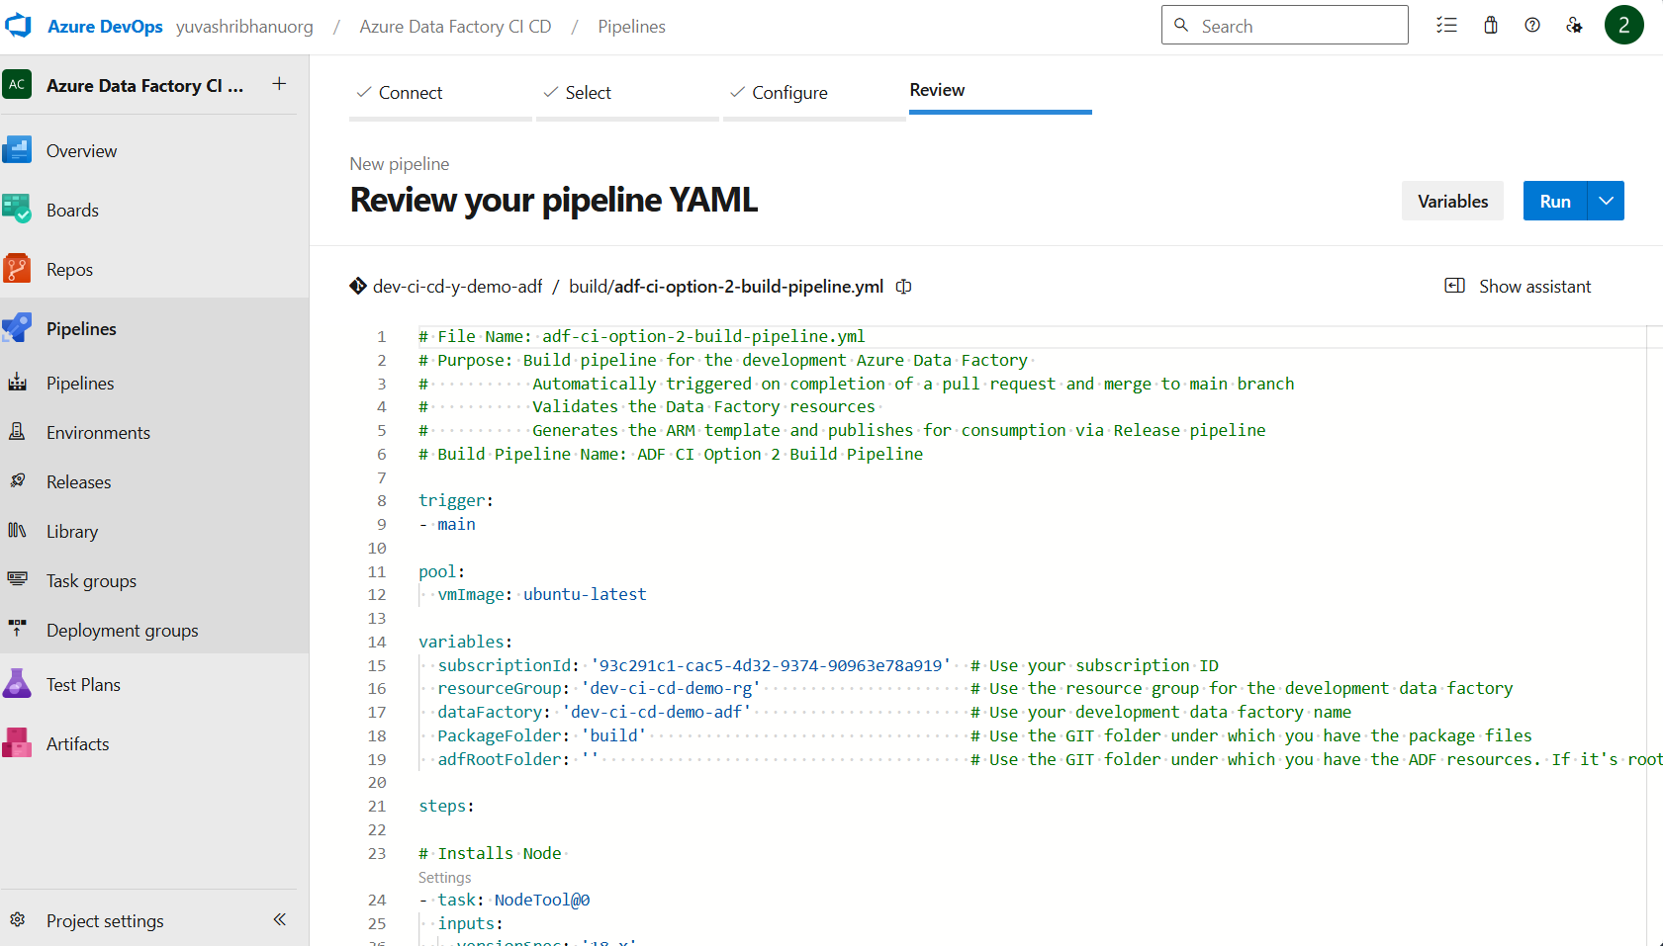
CI/CD Integration
Build Pipeline

Slide 35
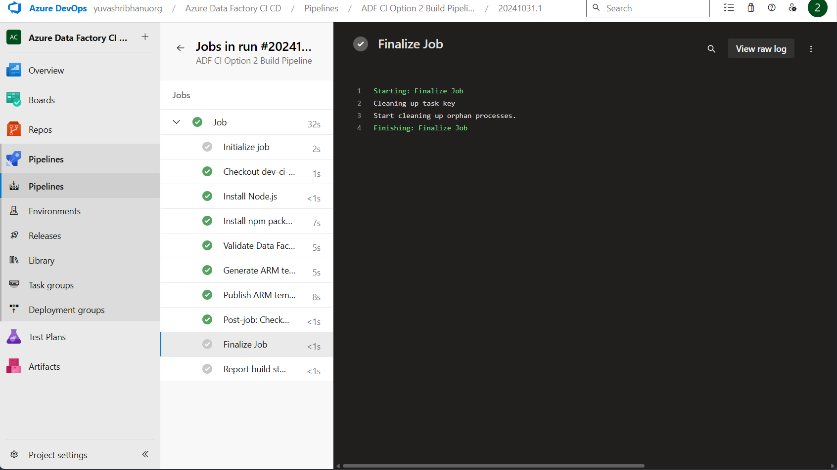
CI/CD Integration
Running the build pipeline by manually triggering it in Azure devops portal

Slide 36
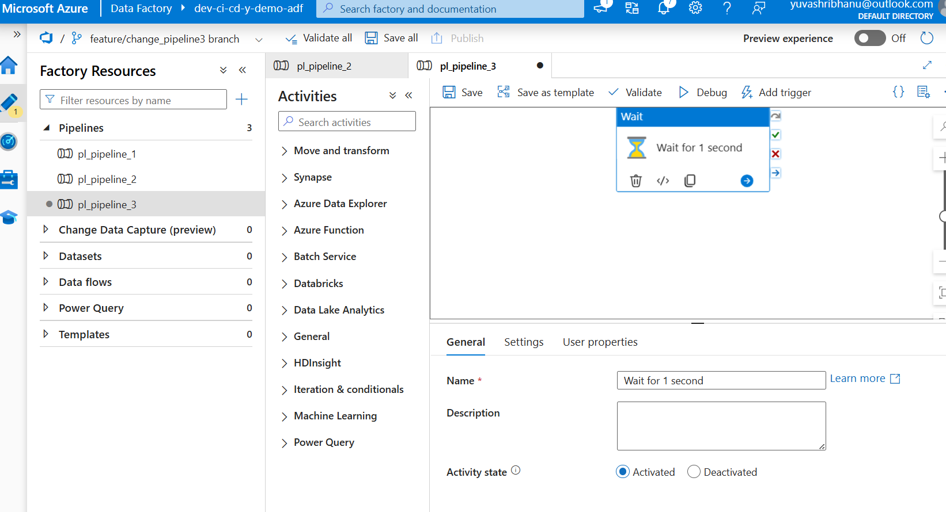
CI/CD Integration
Triggering the build pipeline by making change in Data factory.
Changed the name of the wait activity

Slide 37
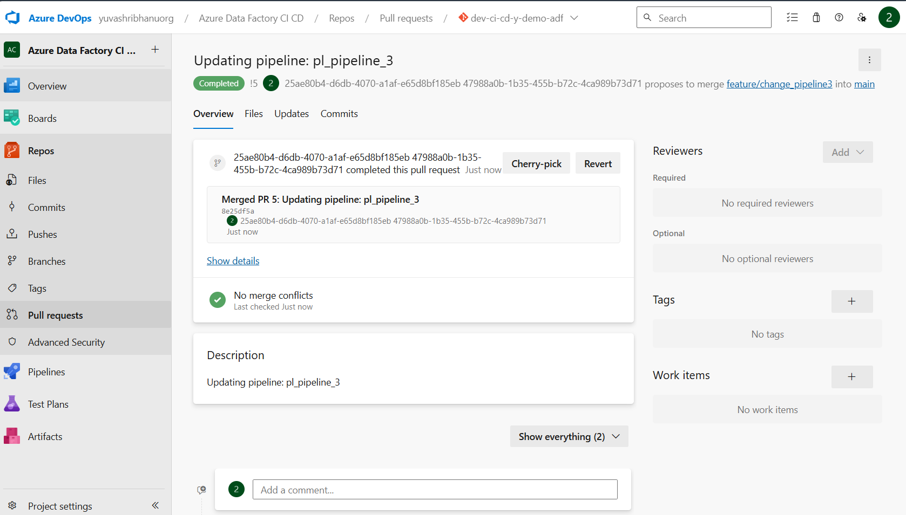
CI/CD Integration
Merge Complete

Slide 38
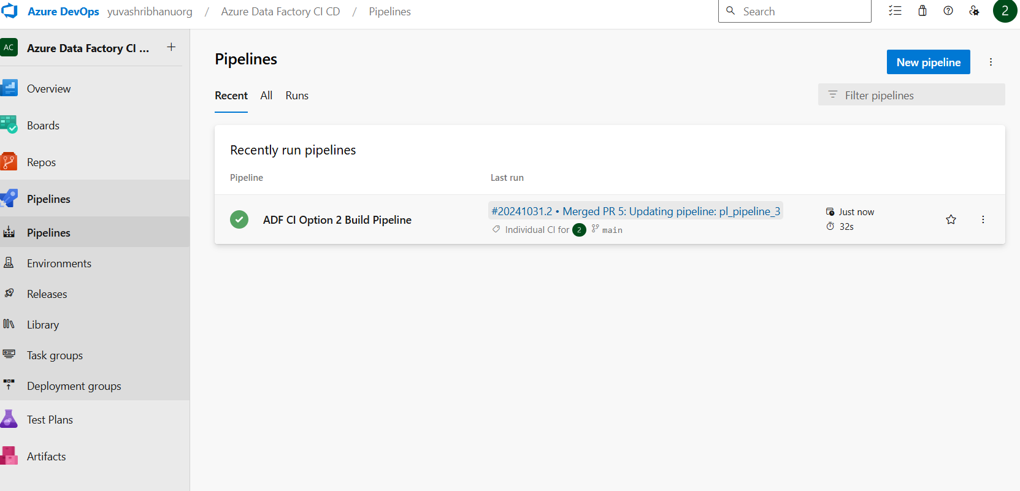
CI/CD Integration
Build pipeline triggered.

Slide 39
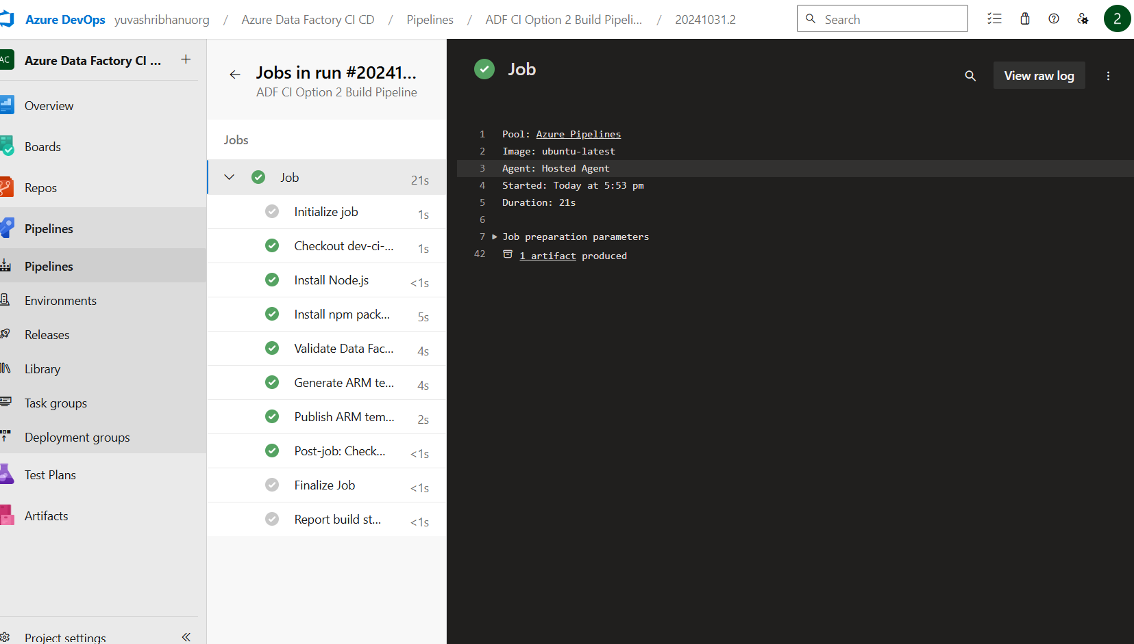
CI/CD Integration
Build pipeline success and arm templates are published.

Slide 40
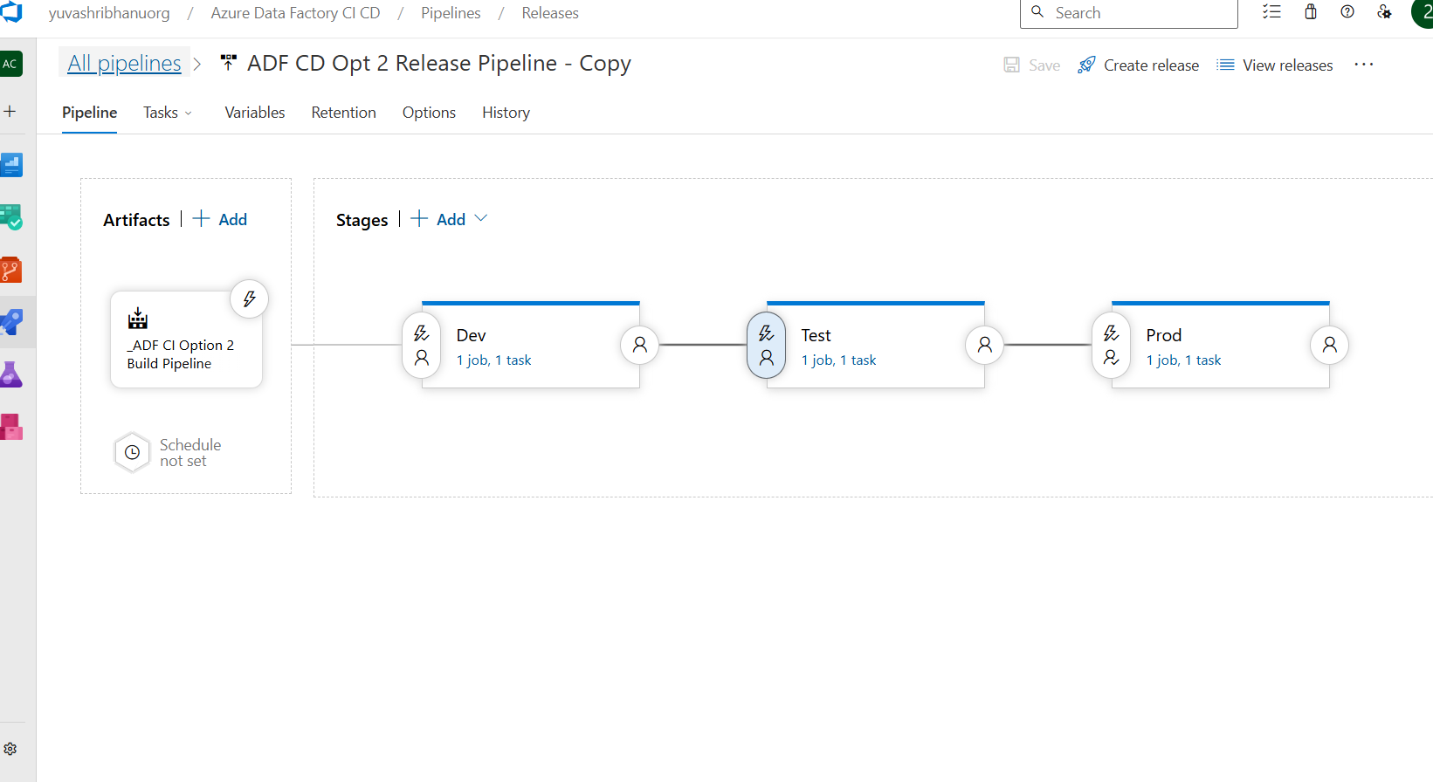
CI/CD Integration
Release pipeline to automatically consume the arm templates when created and publish changes in all three environments

Slide 41
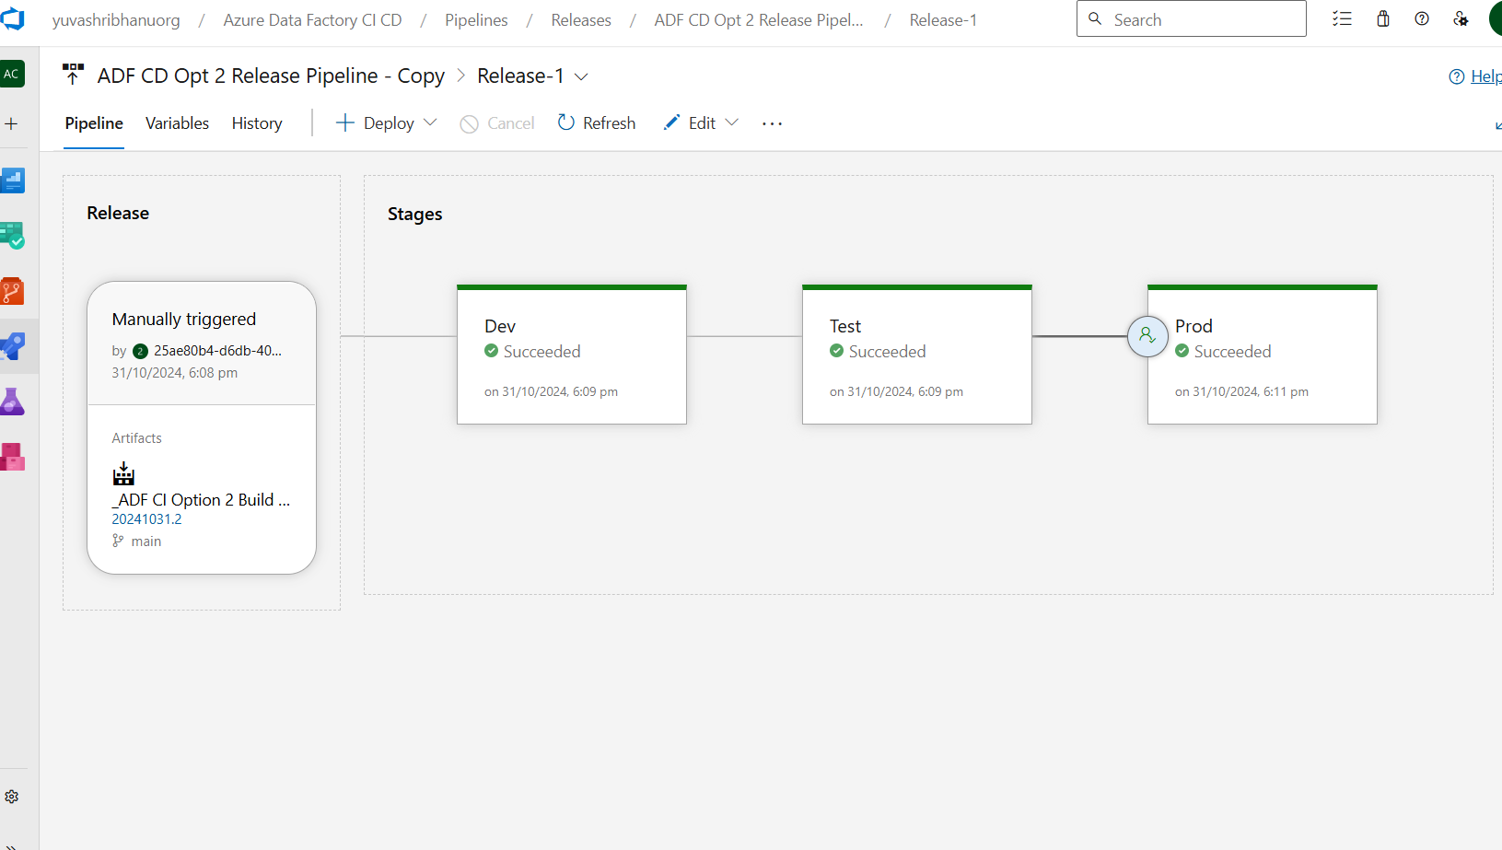
CI/CD Integration
Manually creating a new release.

Slide 42
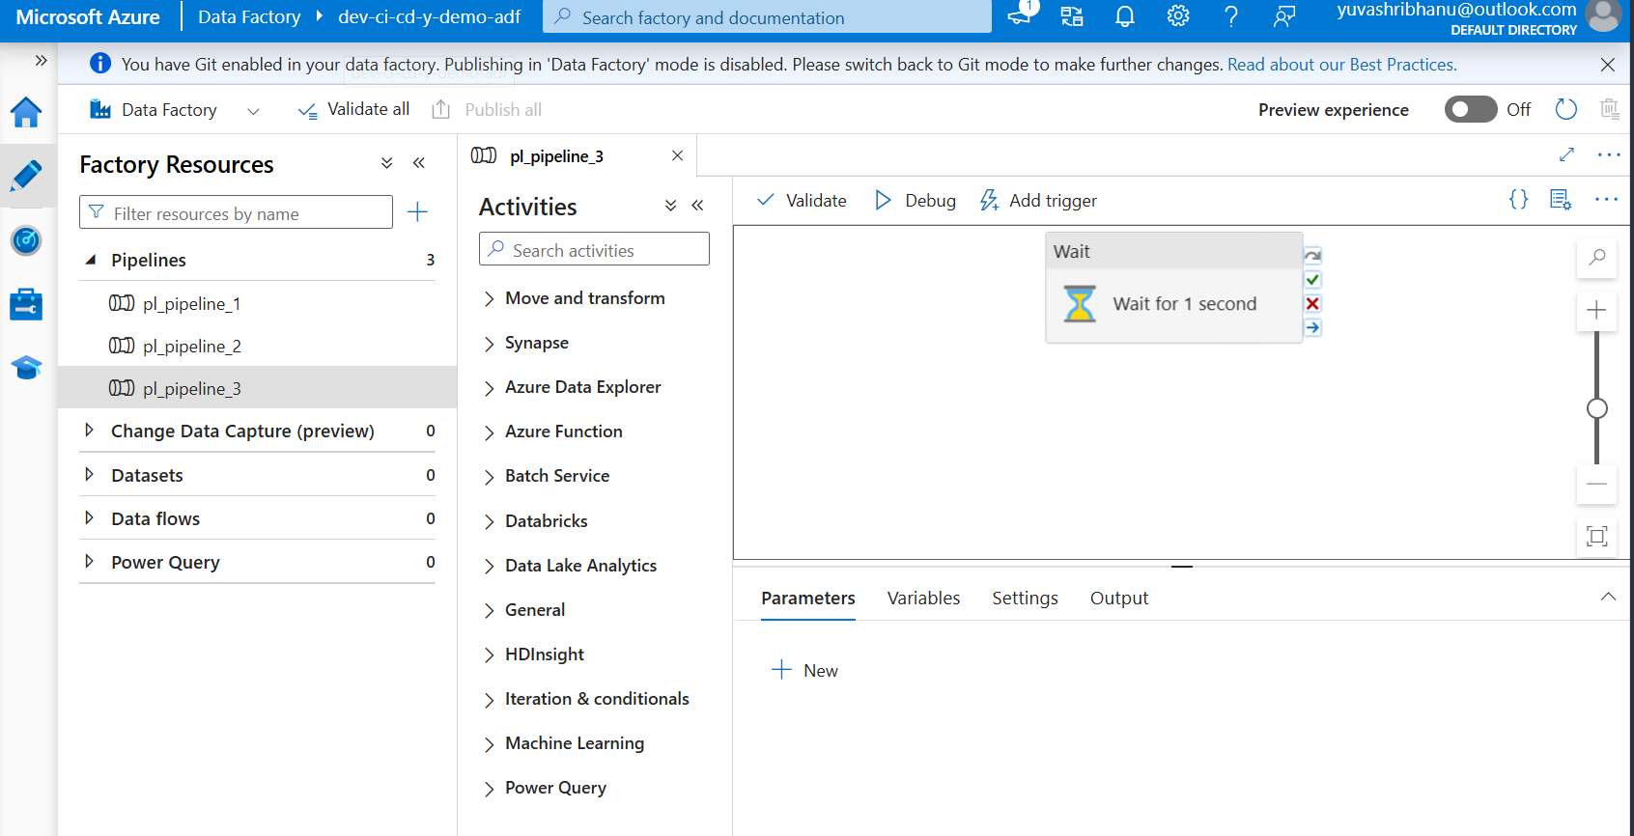
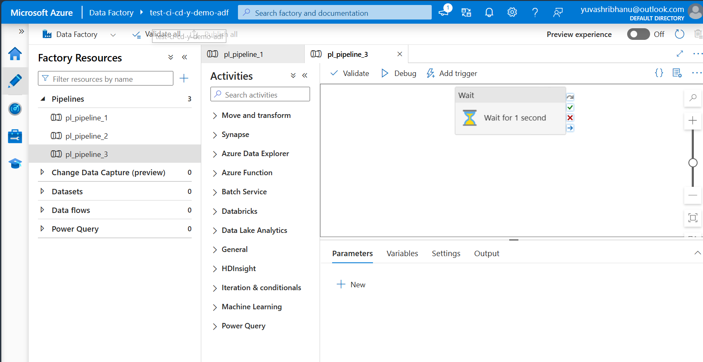
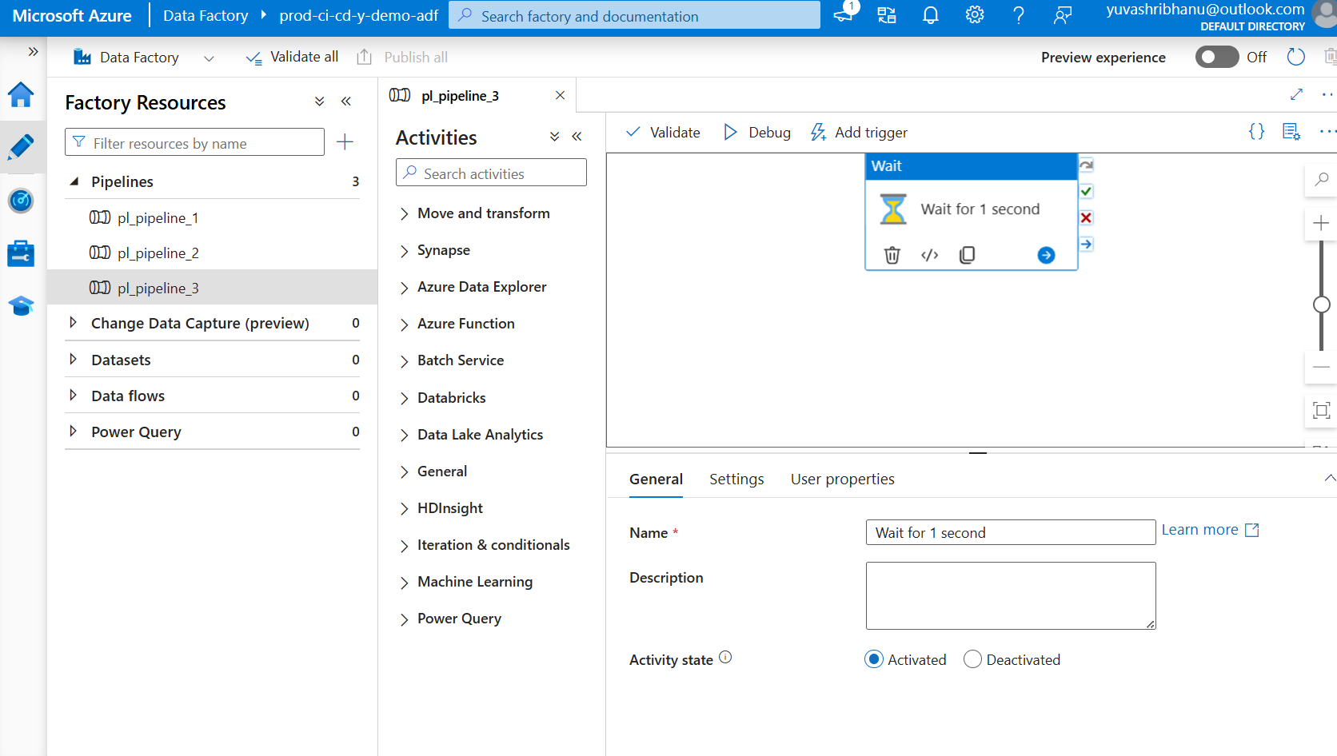
CI/CD Integration
Changes of the wait activity name reflected in dev, test and prod

Slide 43
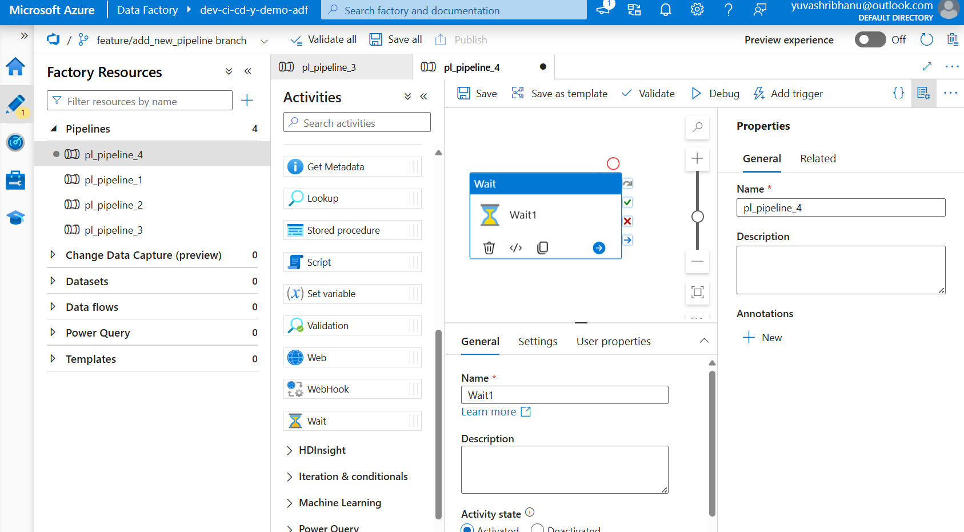
CI/CD Integration
Making another change for end to end testing.
Added a new pipeline

Slide 44
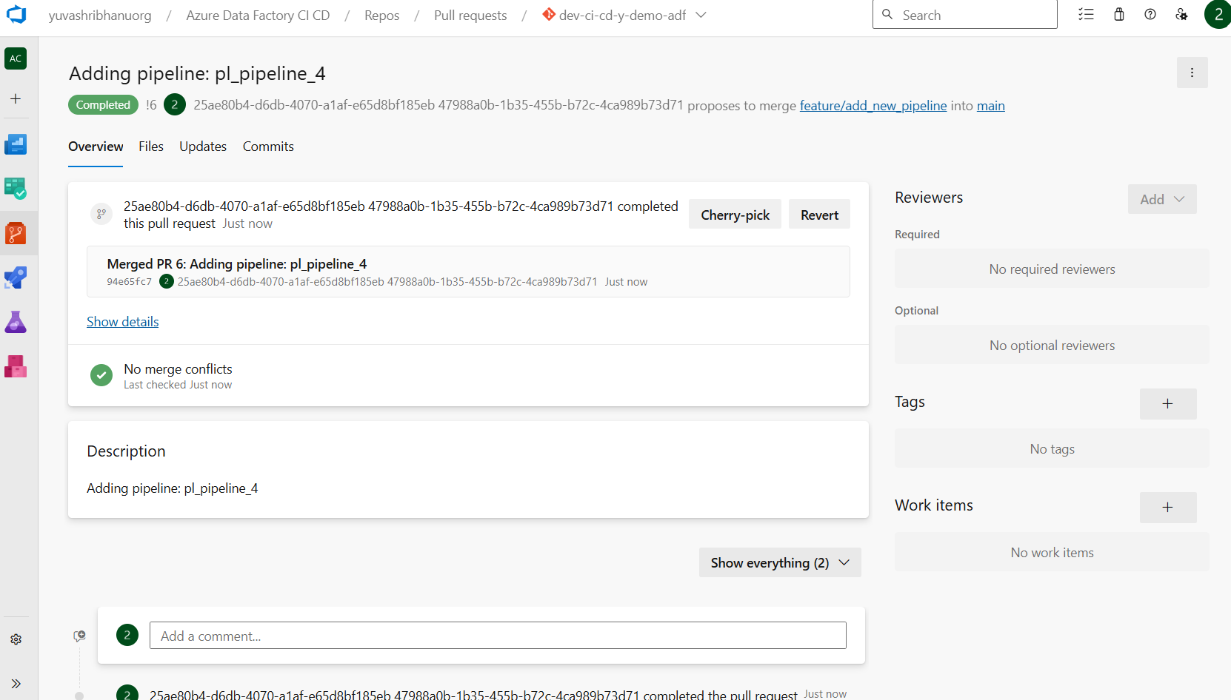
CI/CD Integration
Pull request completed and merge completed

Slide 45
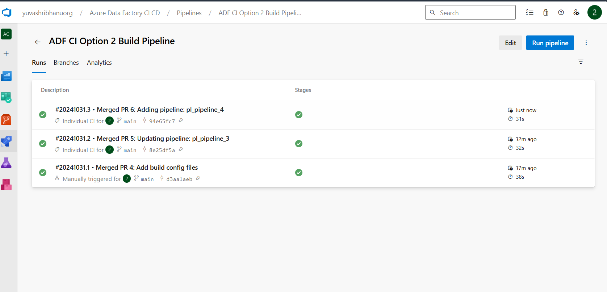
CI/CD Integration
Build pipeline triggered to create and publish arm templates

Slide 46
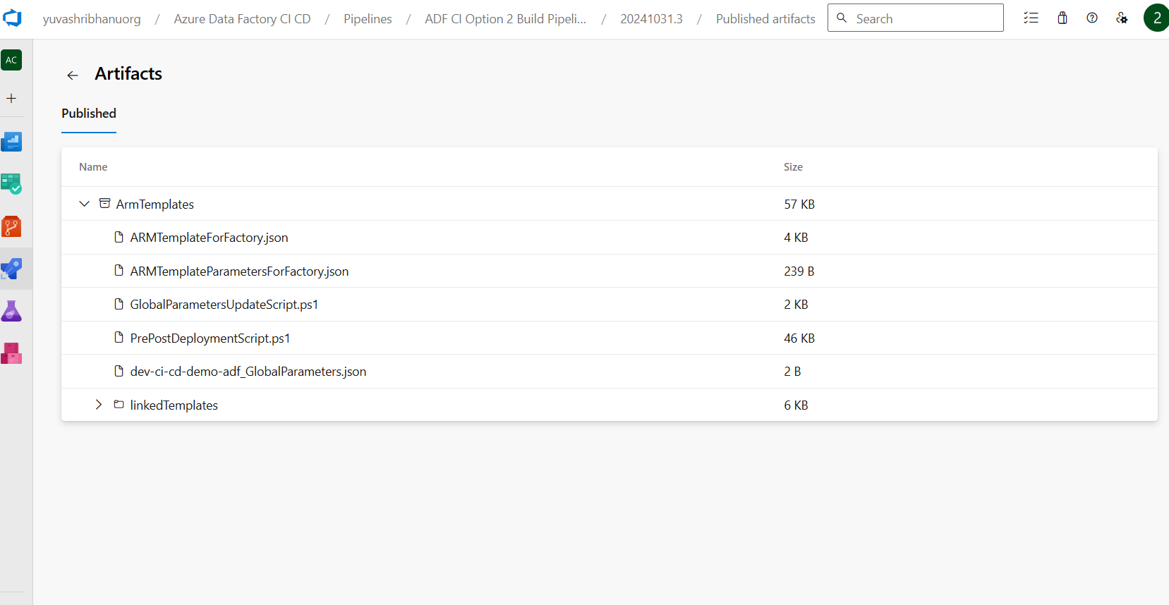
CI/CD Integration
Arm templates artifact

Slide 47
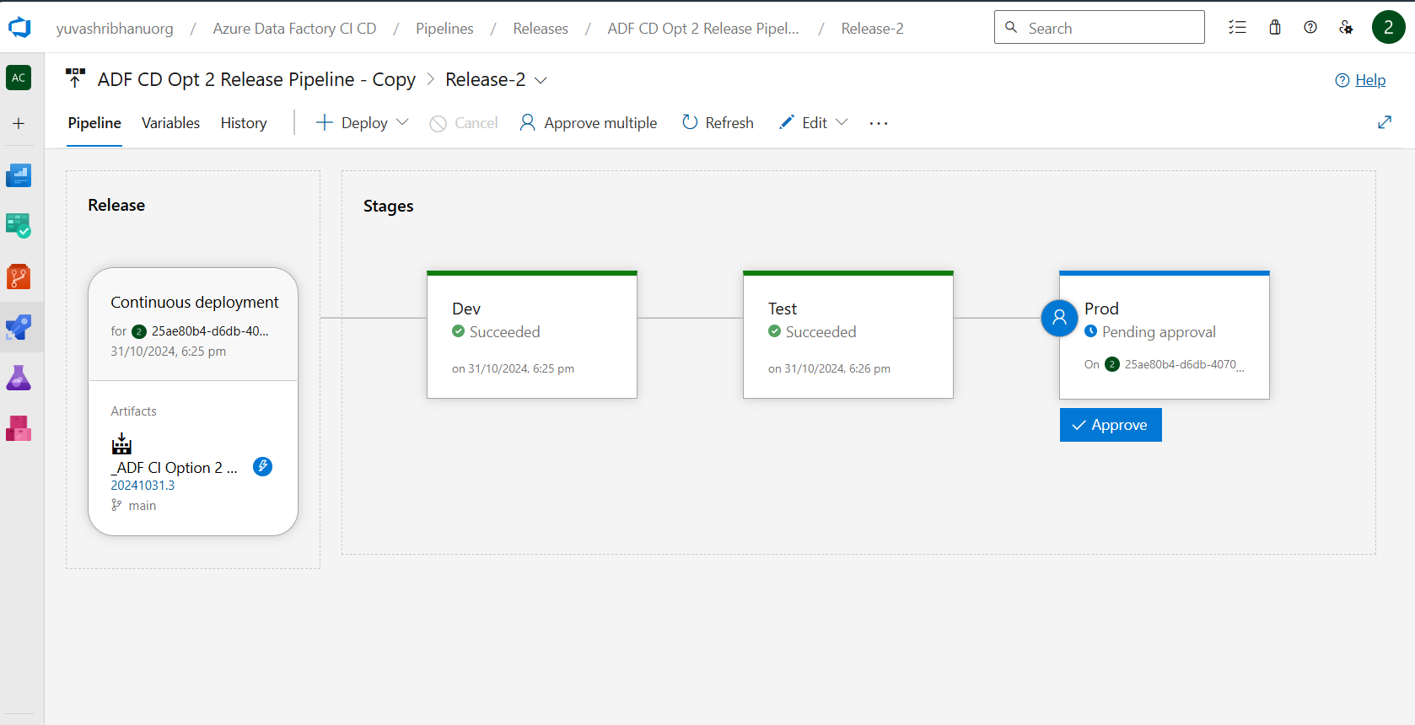
CI/CD Integration
Release pipeline triggered and waiting for approval to push changes to prod

Slide 48
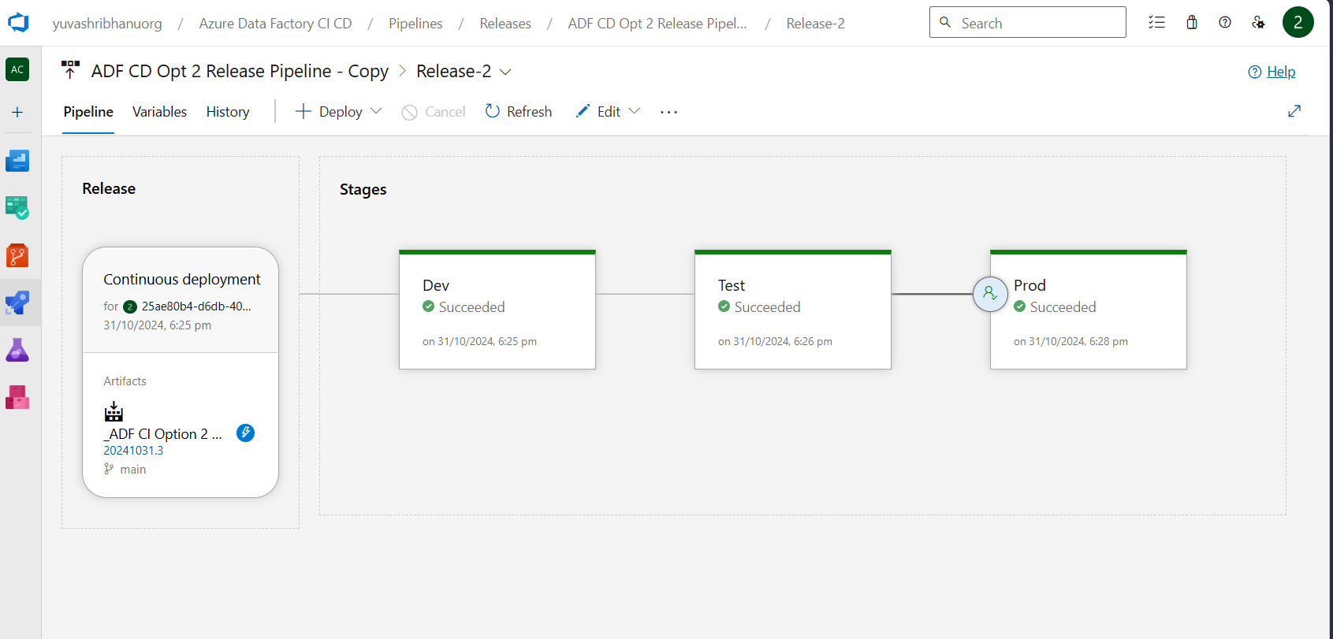
CI/CD Integration
Release pipeline triggered and complete

Slide 49
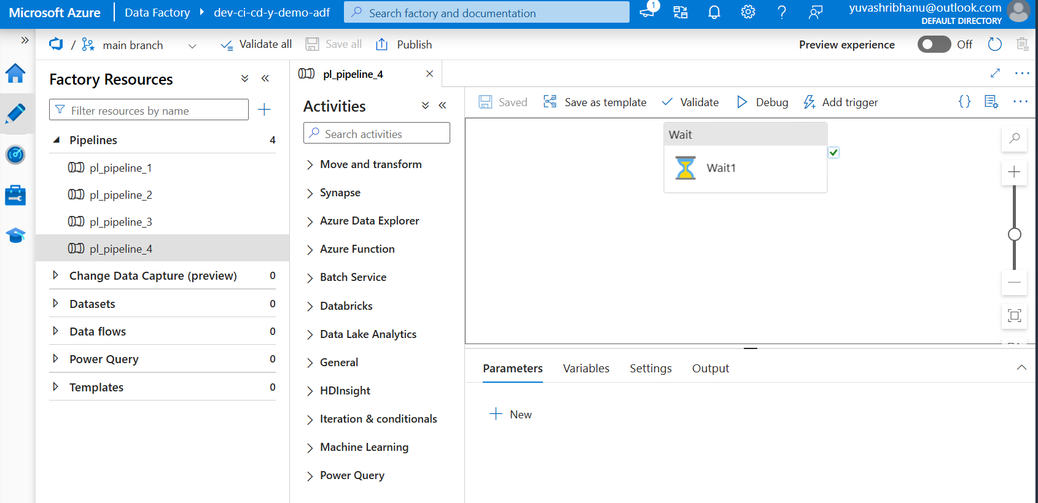
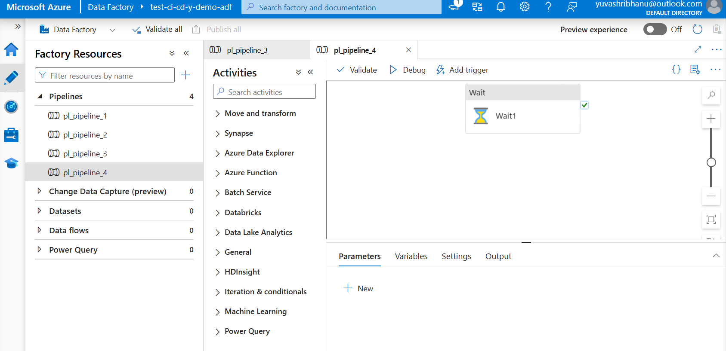
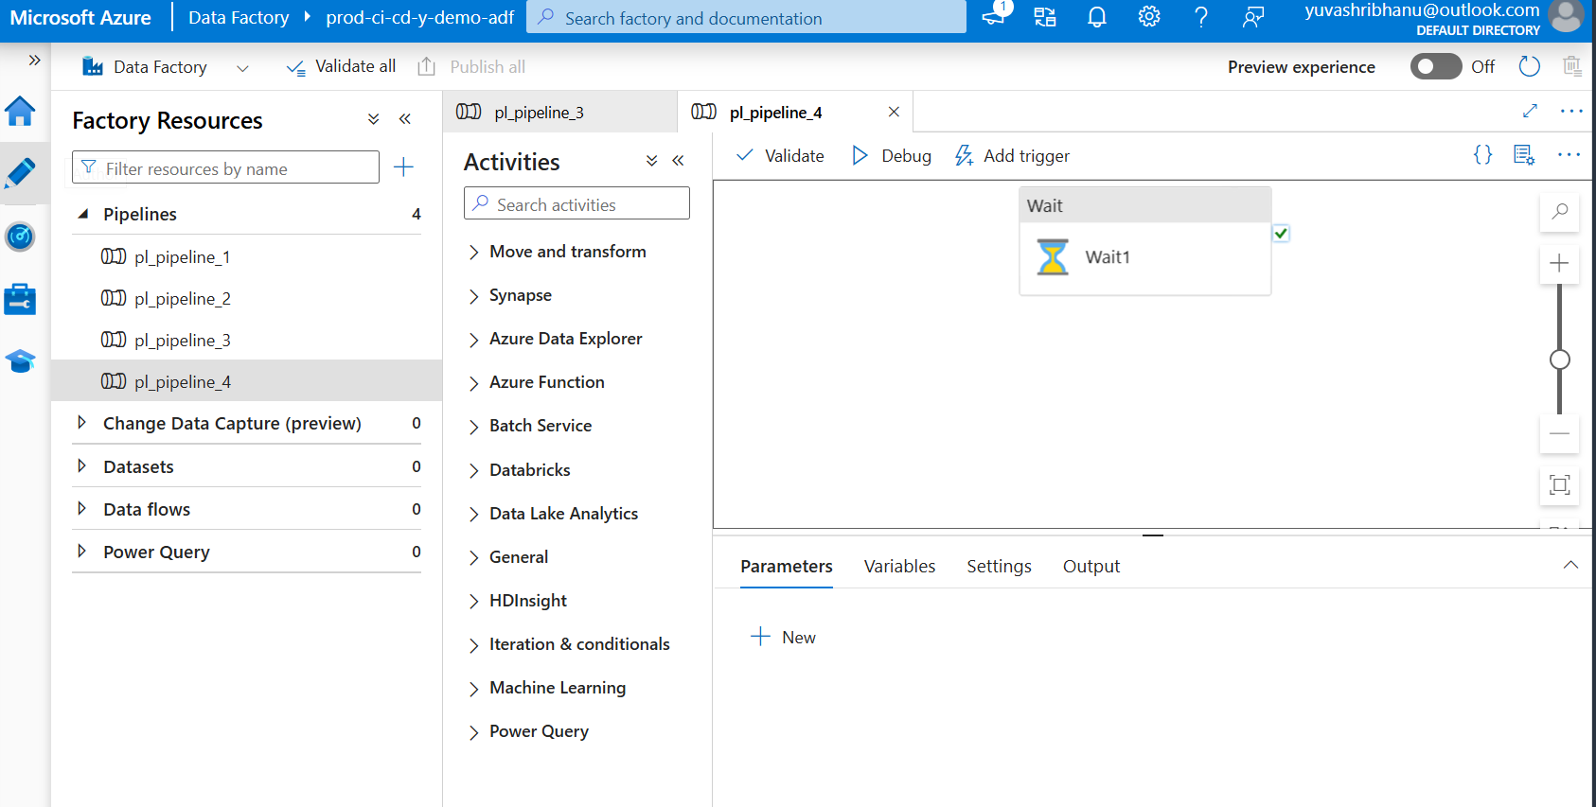
CI/CD Integration
New pipeline created in dev, test and prod

